Slide 1
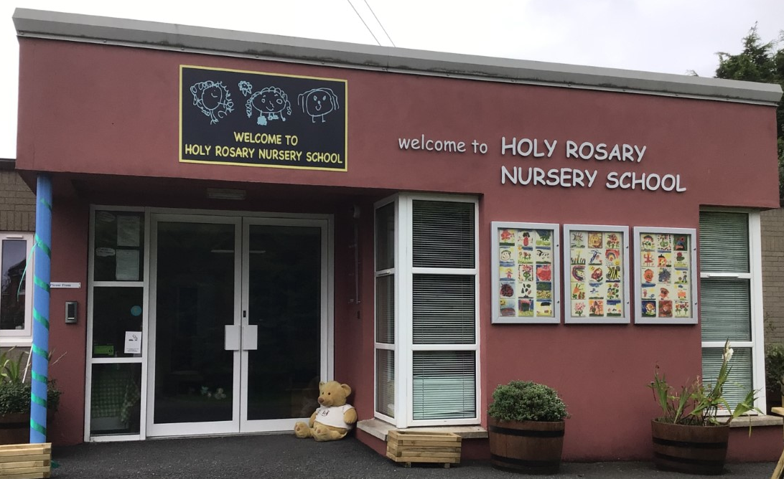
Holy Rosary Nursery School Our forest school diary 18th April 2023
Forest School Awards - The outreach
programme for Learning Without Walls

Slide 2
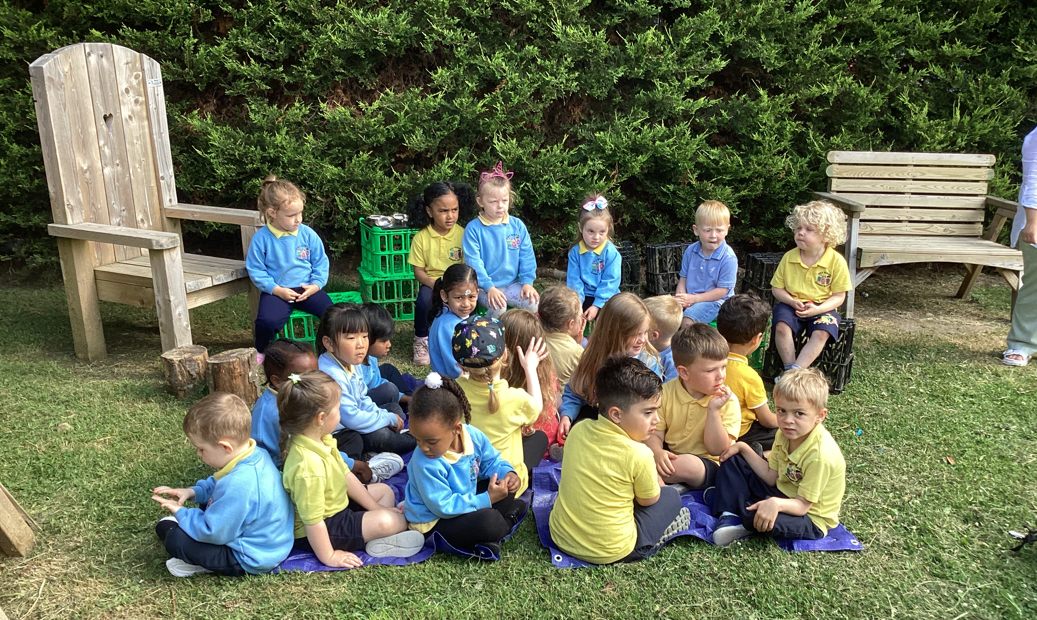
Safety first!
Forest School Awards - The outreach
programme for Learning Without Walls
We made sure the site was safe and listened carefully to what we had to do!

Slide 3
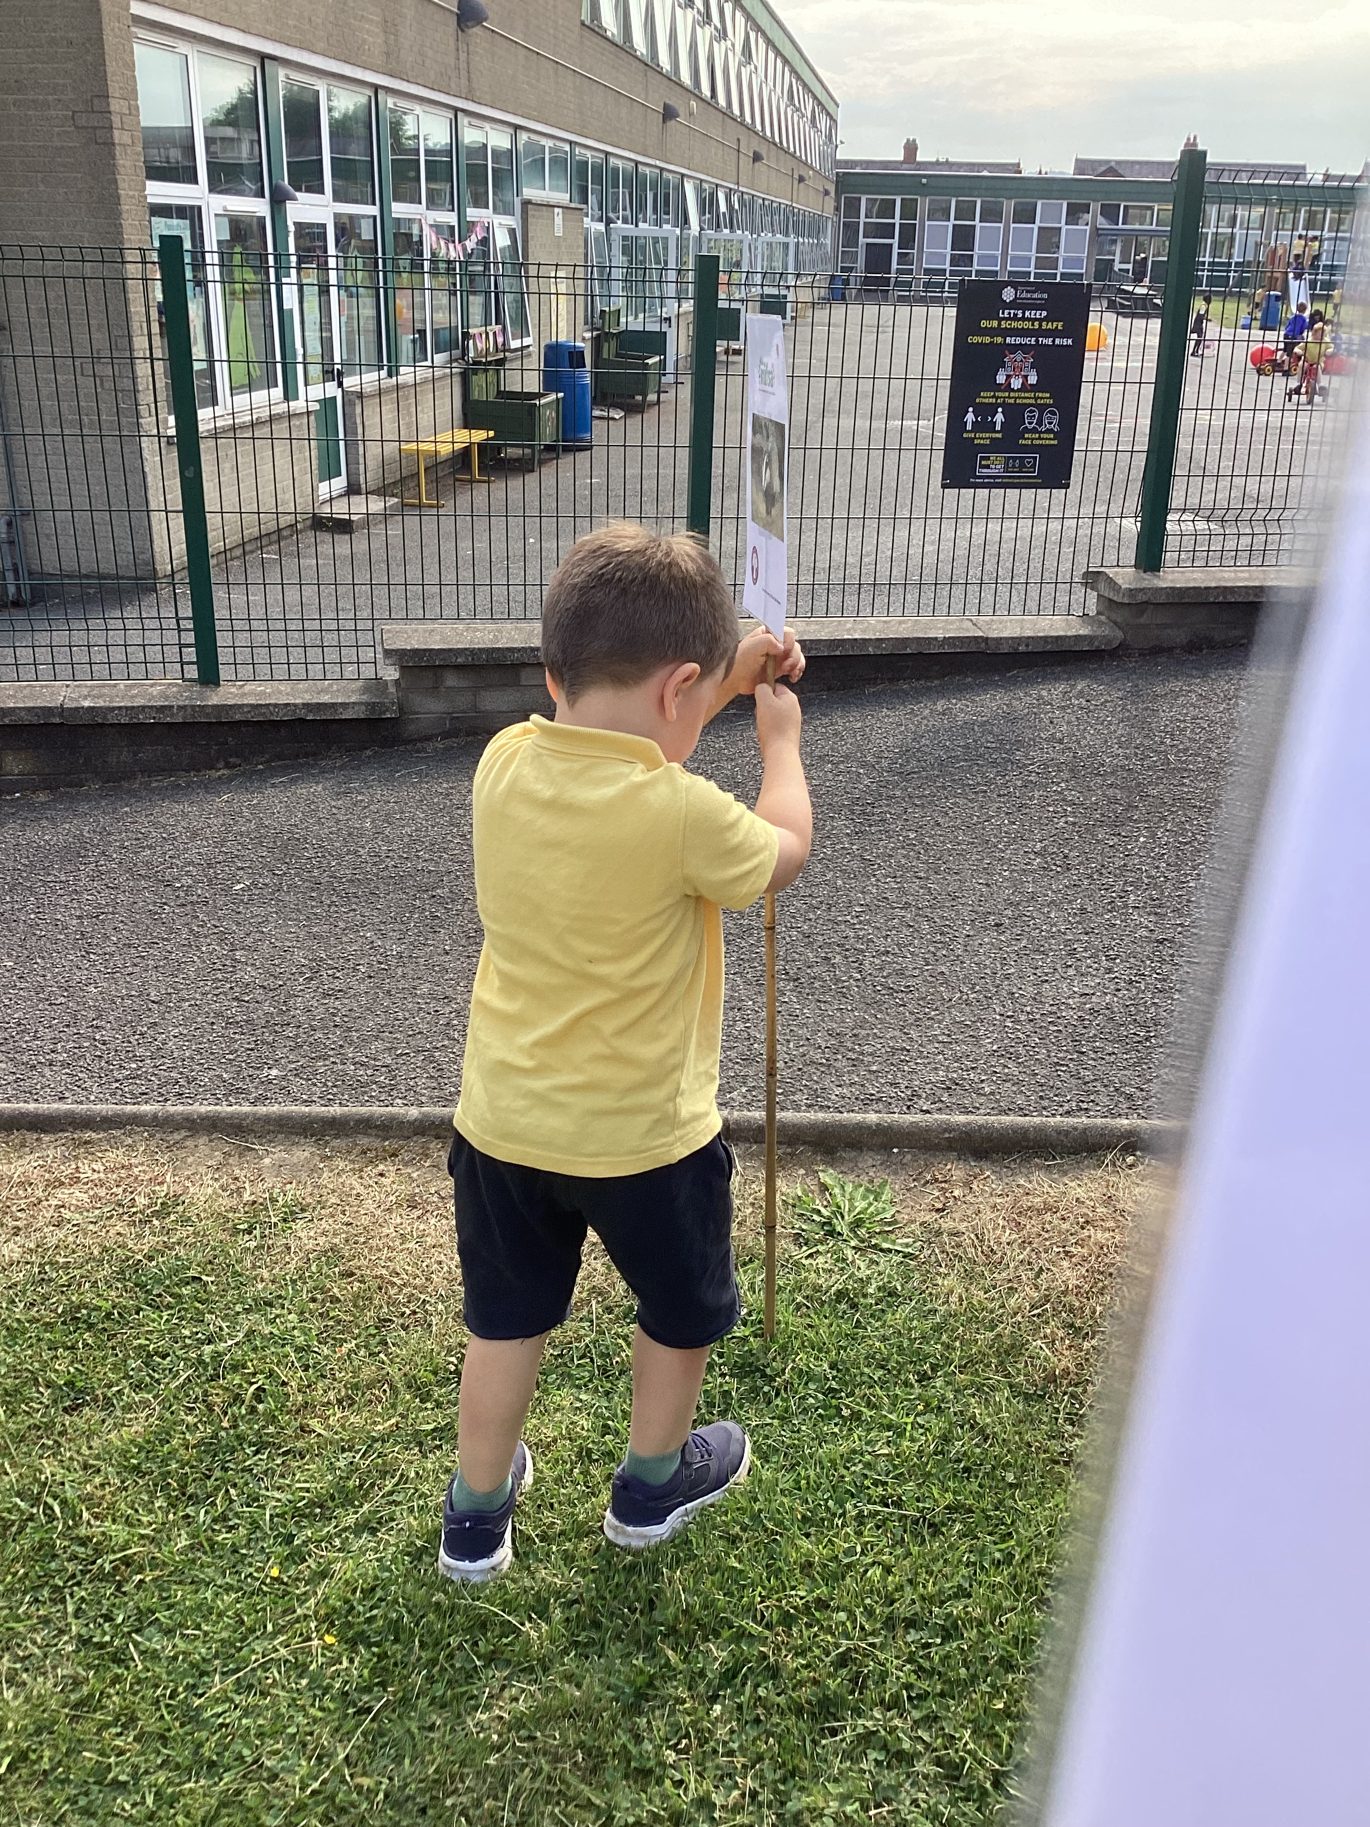
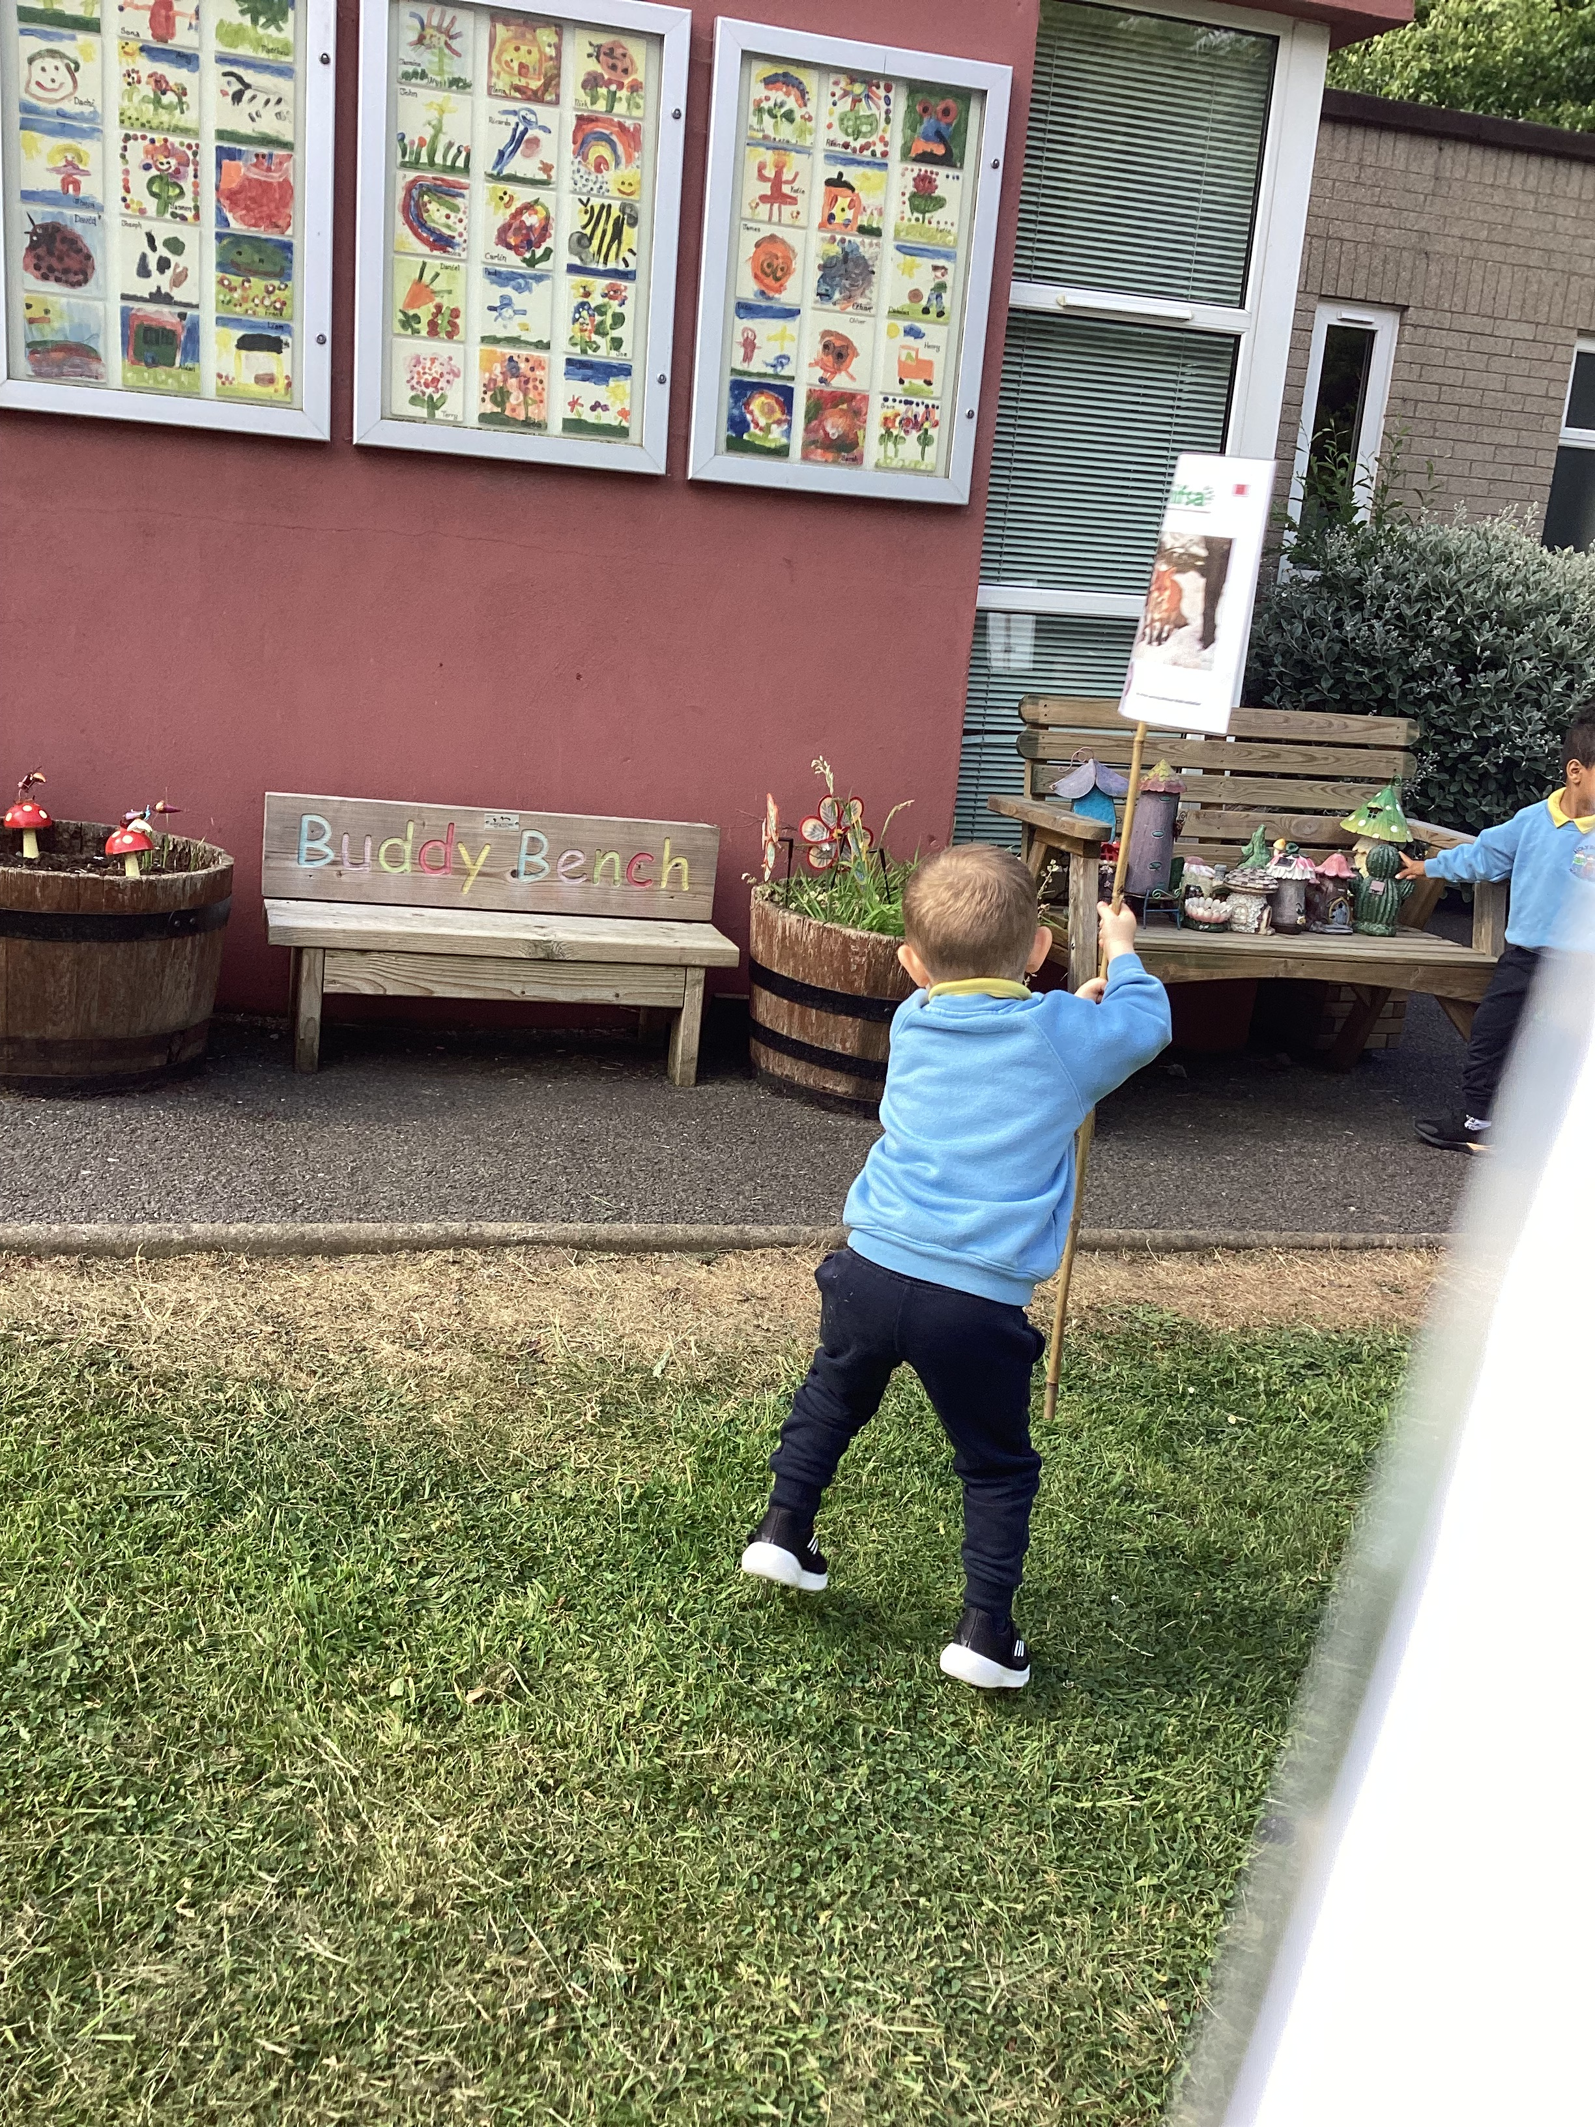
Boundary flags
Forest School Awards - The outreach
programme for Learning Without Walls
We put out the boundary flags so we know the area we have to stay inside

Slide 4
Rules
We go through the rules – 1 whistle means stop, 2 whistles mean come back to base and the 3rd rule is to have fun & learn!
Forest School Awards - The outreach
programme for Learning Without Walls

Slide 5
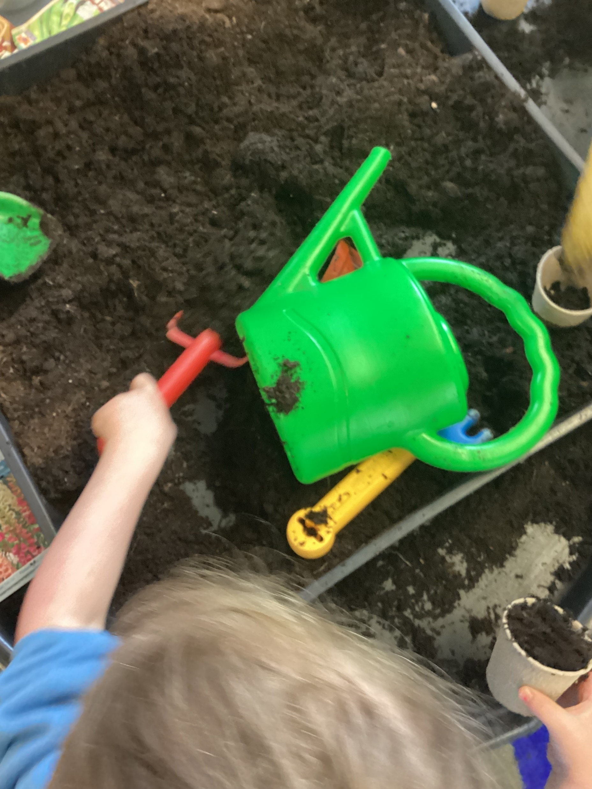
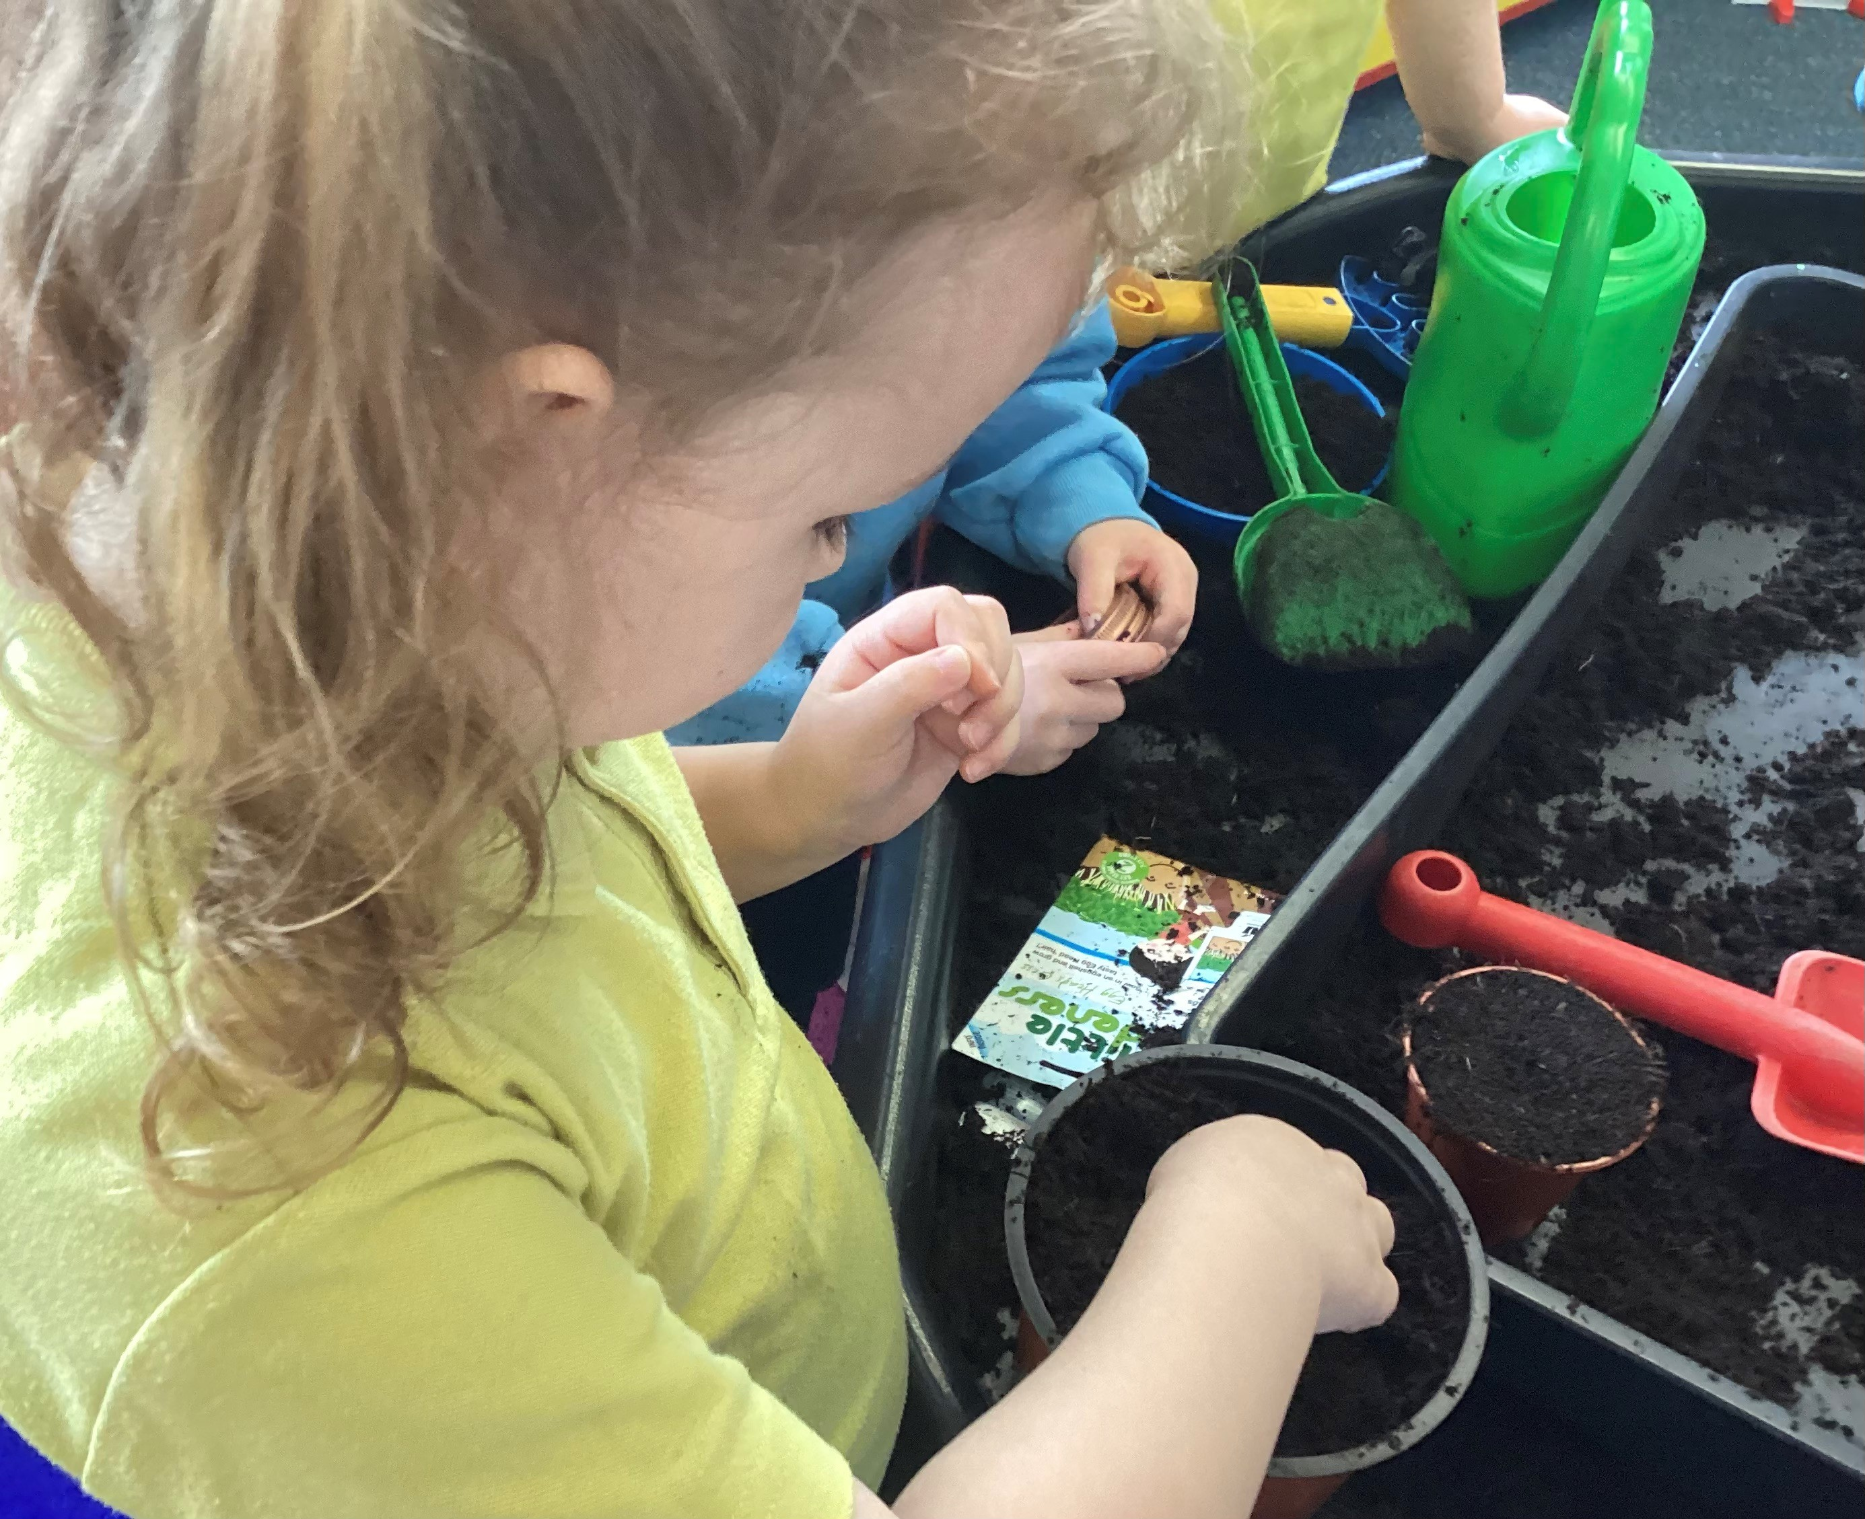
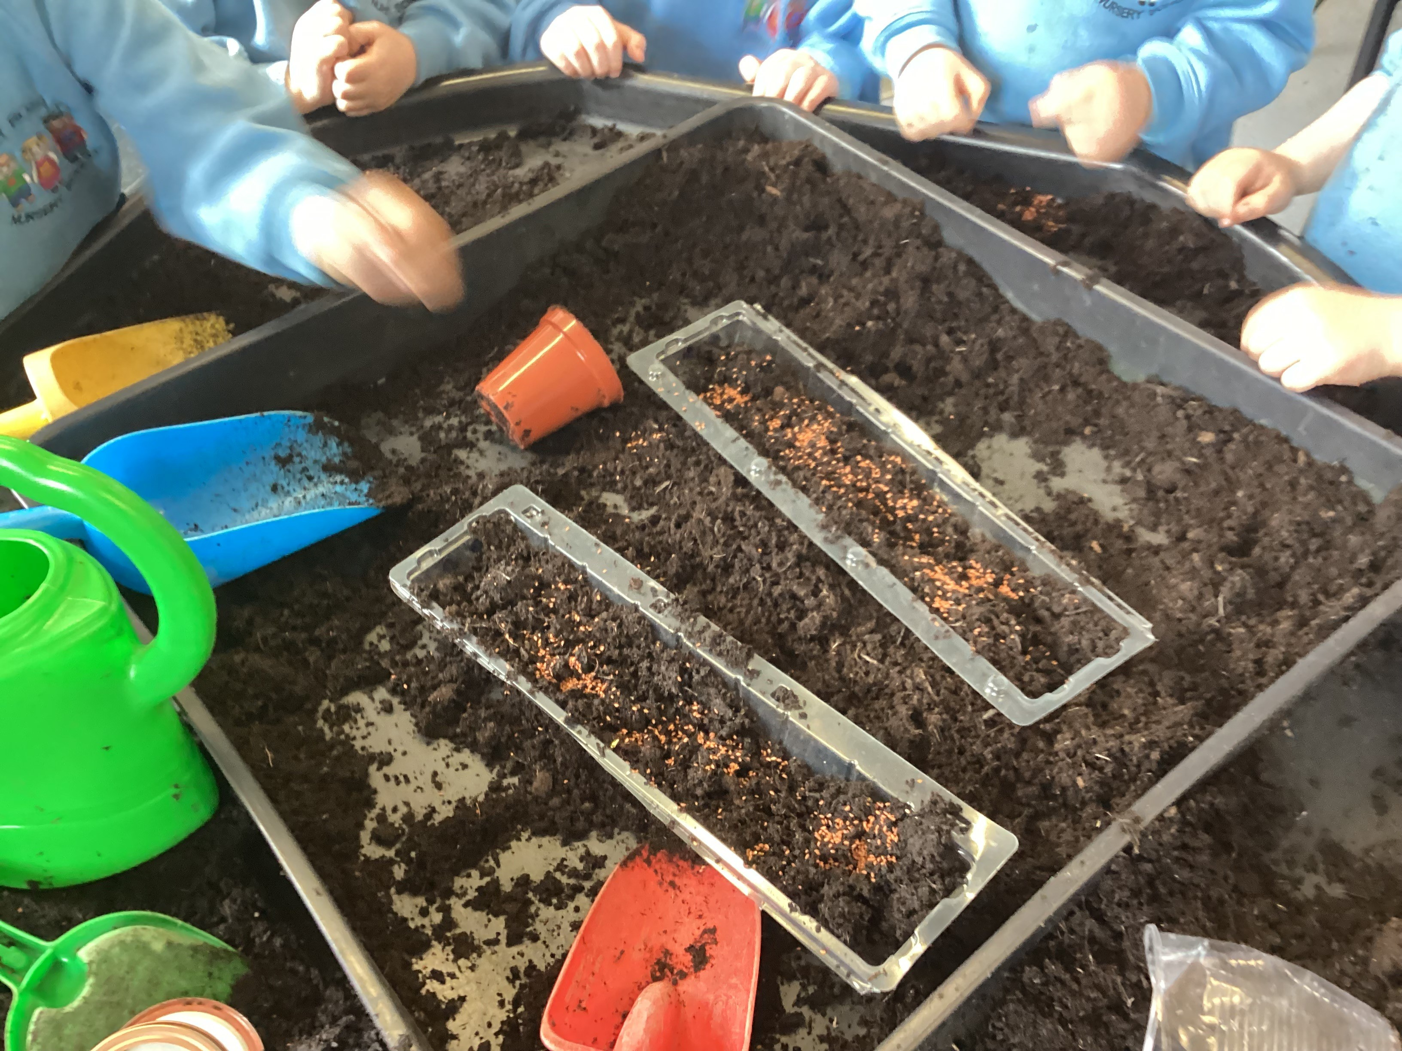
Planting
We planted a variety of seeds in our Forest School Area.
We learnt what plants need to grow and survive.
Forest School Awards - The outreach
programme for Learning Without Walls

Slide 6
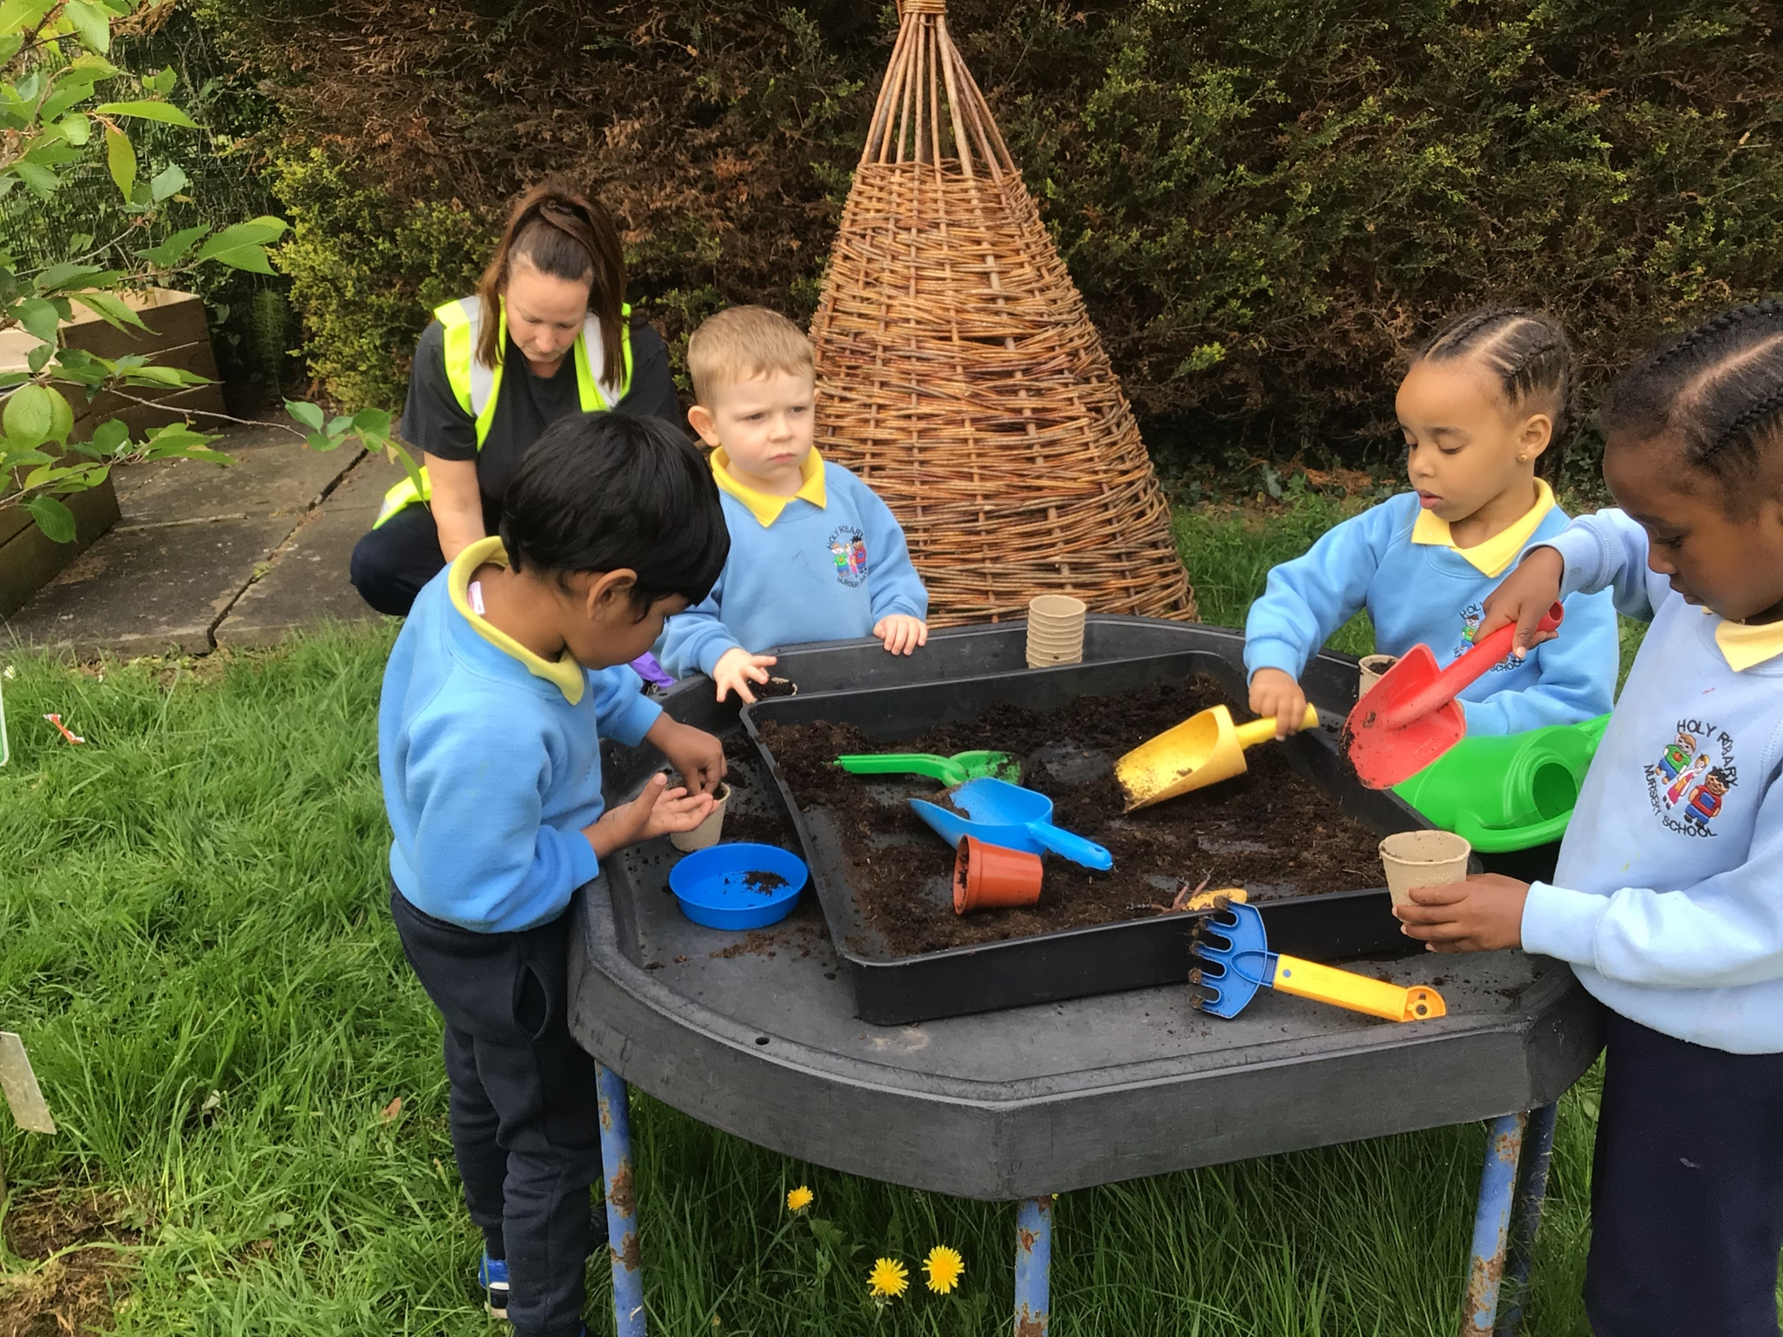
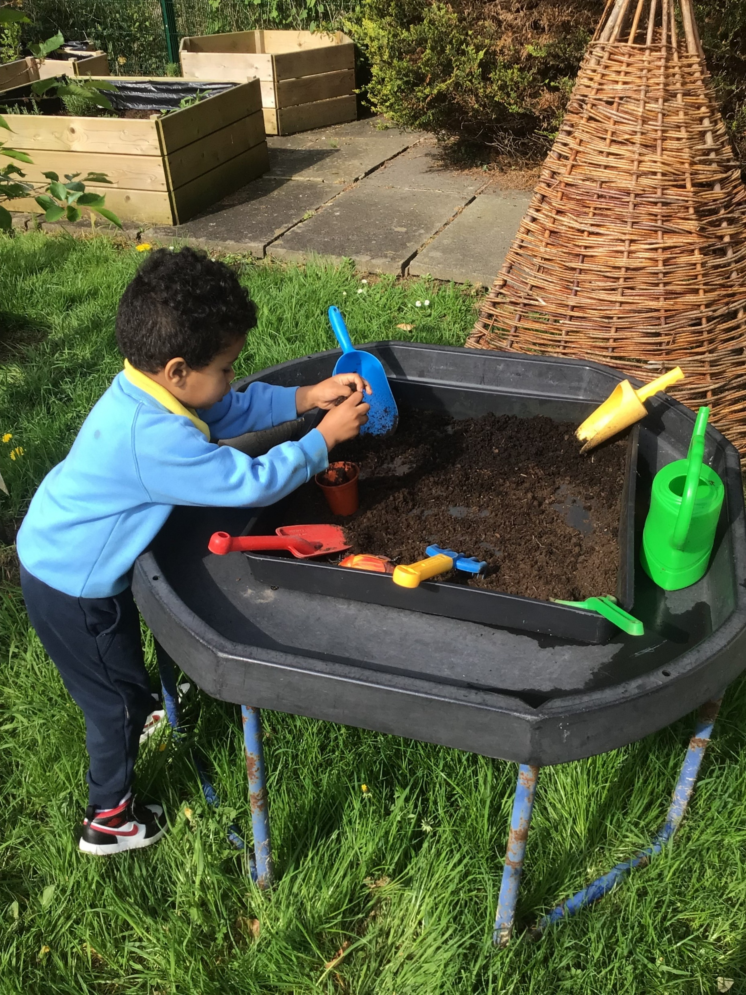
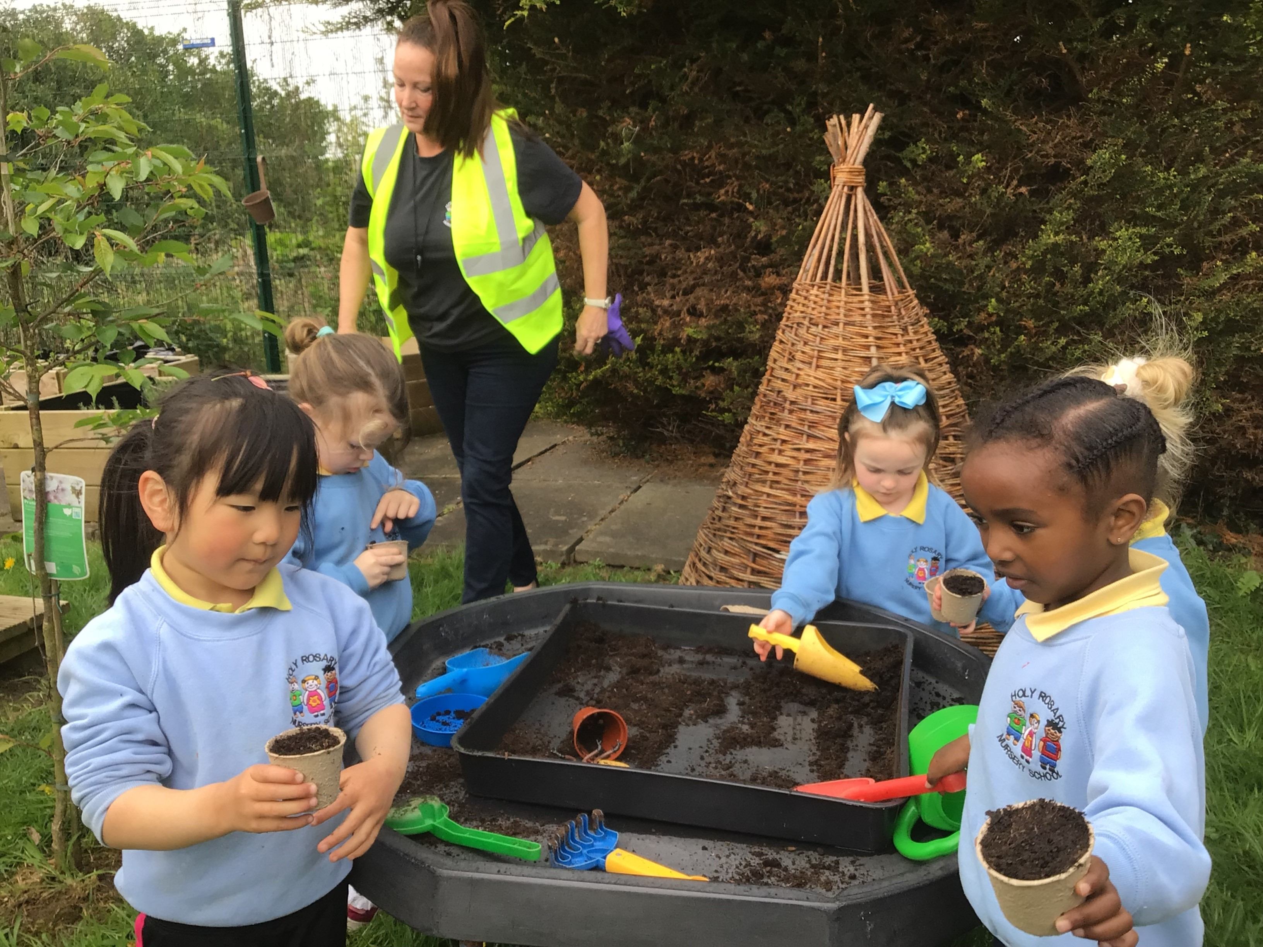
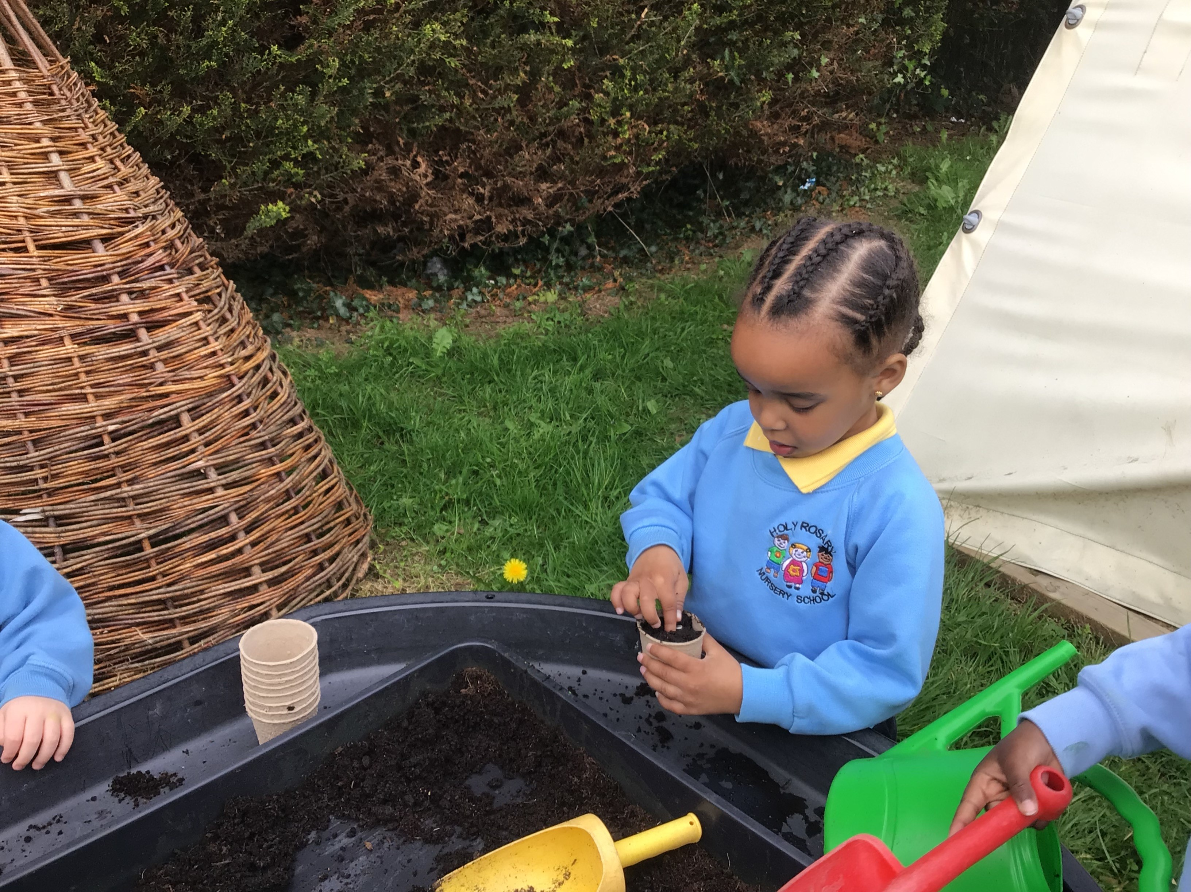
Planting
Forest School Awards - The outreach
programme for Learning Without Walls
We planted in a variety of places; pots, baskets, planters and the ground!

Slide 7
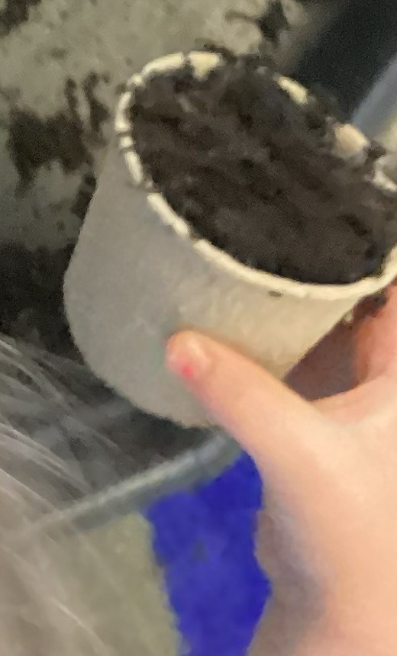
Planting
Forest School Awards - The outreach
programme for Learning Without Walls
We will take care of all our plants each day and will take some home to look after with our families too!

Slide 8
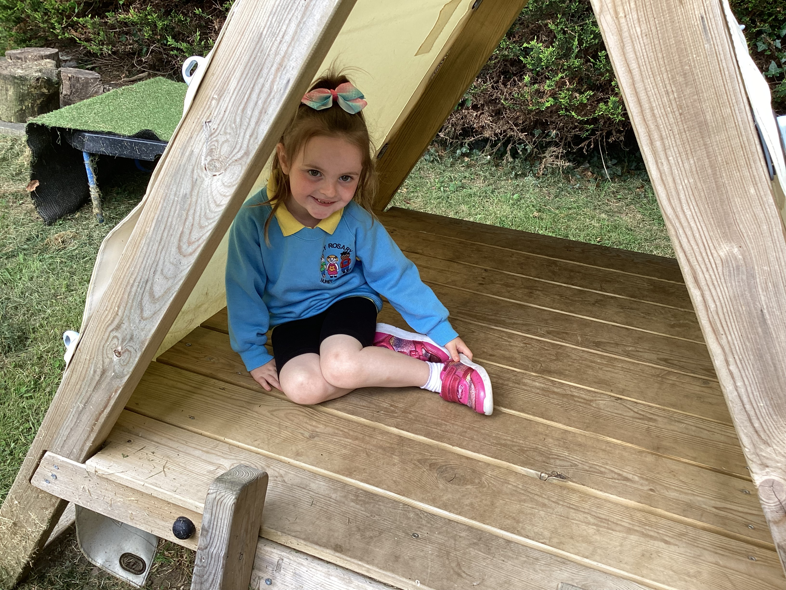
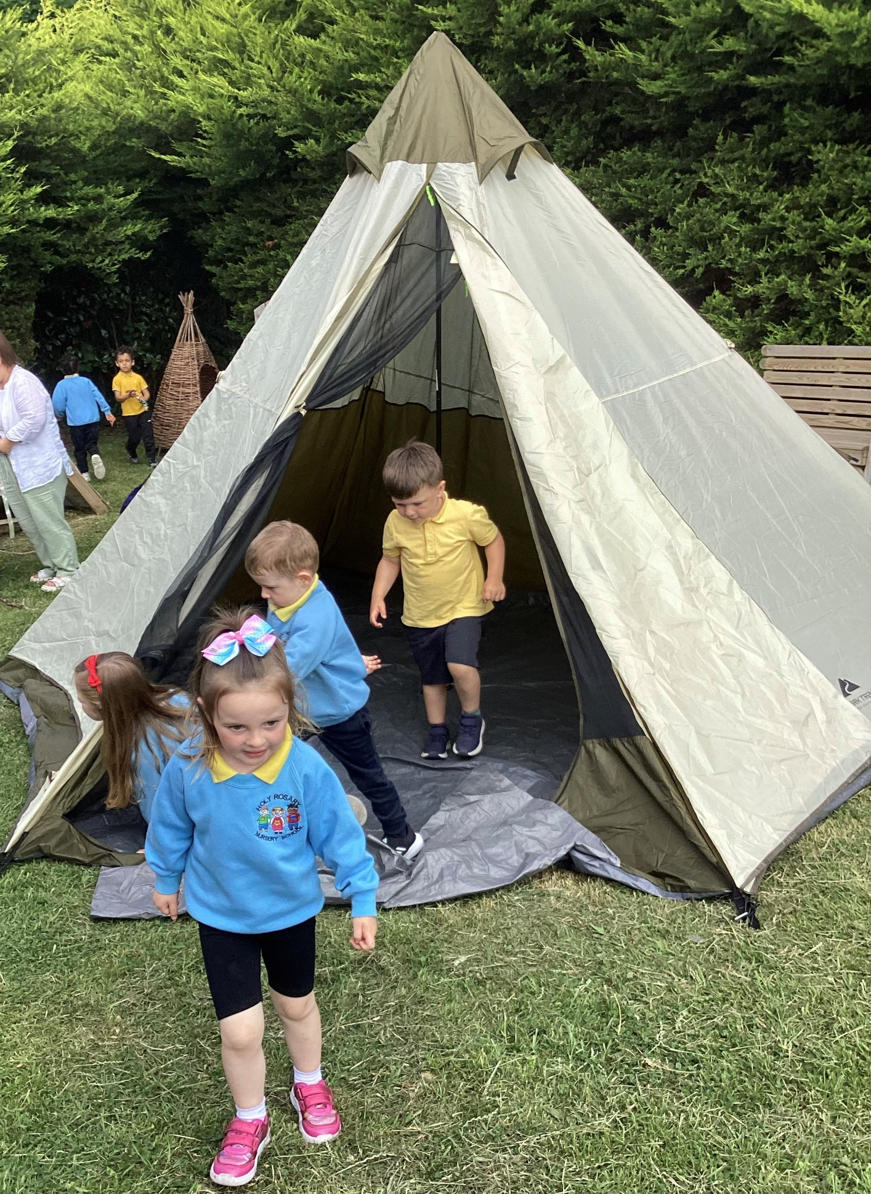
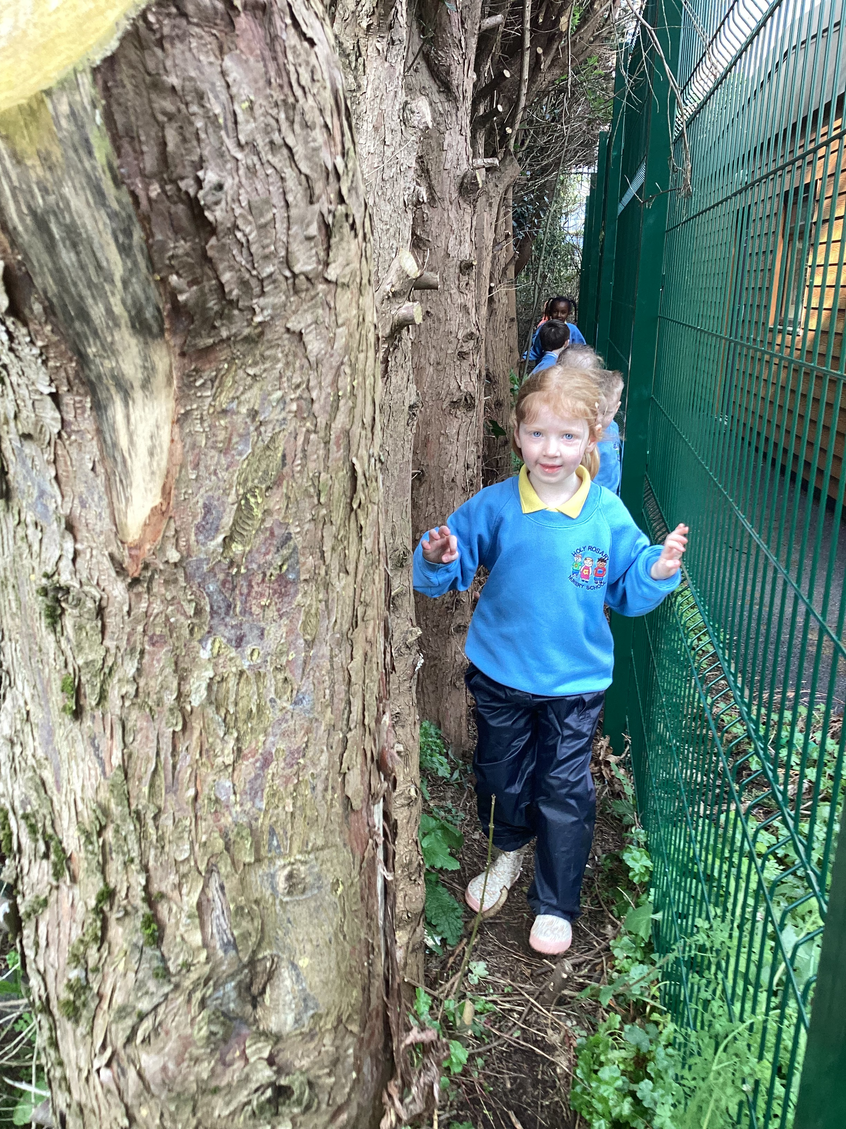
Play time!
We finished our session with some play time!
Forest School Awards - The outreach
programme for Learning Without Walls

Slide 9
Evaluation
Everyone loved the planting activities today. No sad faces!
Forest School Awards - The outreach
programme for Learning Without Walls
or
???

Slide 10
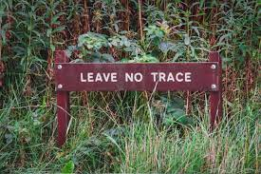
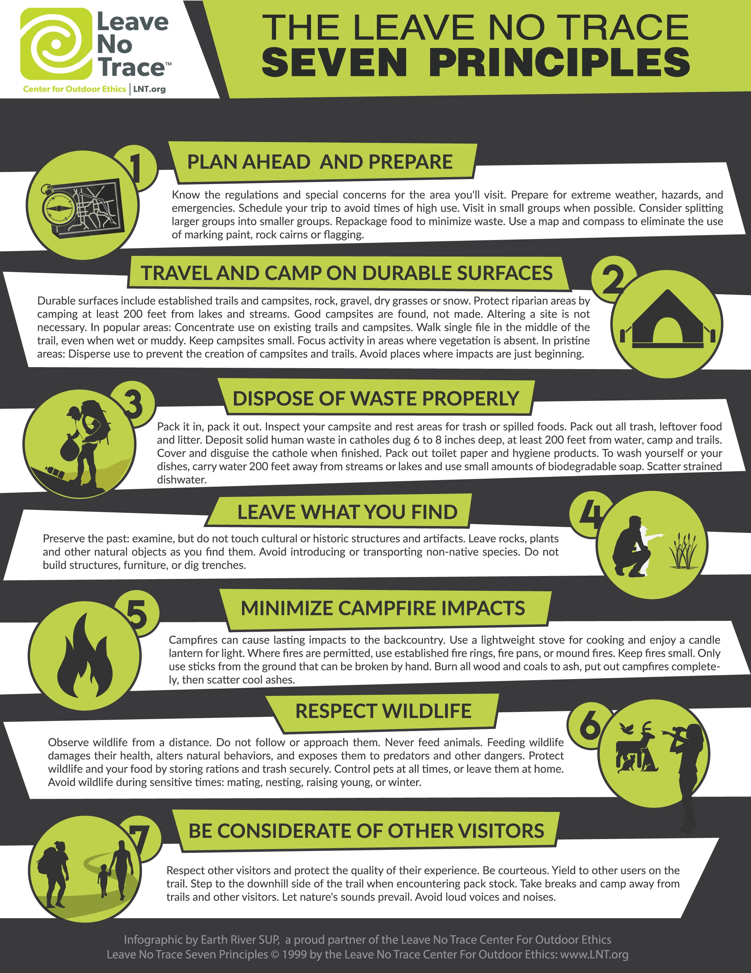
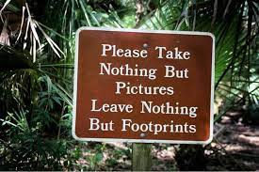
Leave no trace
Everyone helped to tidy up our site and leave no trace, in keeping with Forest School philosophy.
Forest School Awards - The outreach
programme for Learning Without Walls

