Slide 1
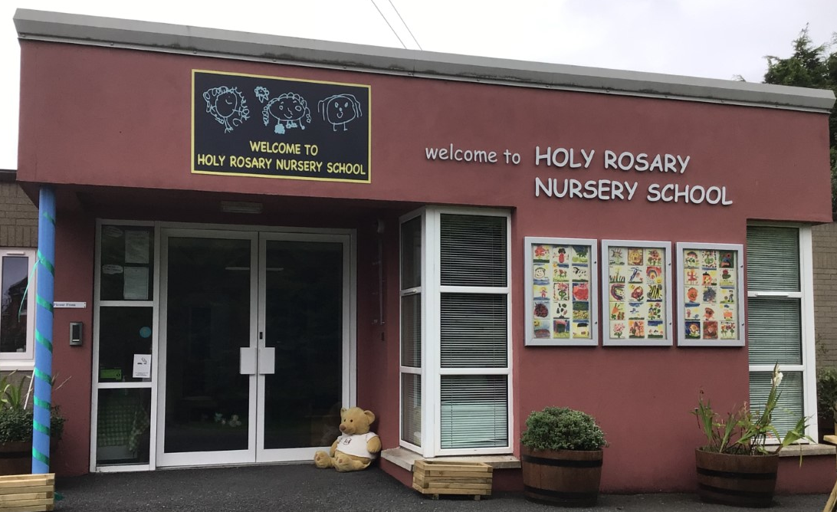
Holy Rosary Nursery School Our forest school diary 3rd May 2023
Forest School Awards - The outreach
programme for Learning Without Walls

Slide 2
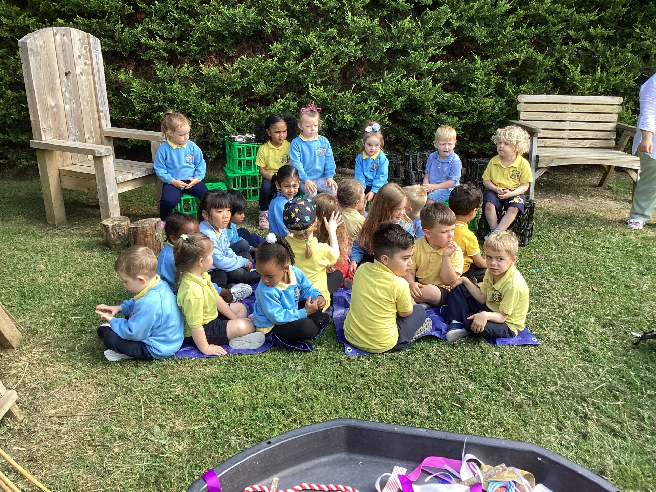
Safety first!
Forest School Awards - The outreach
programme for Learning Without Walls
We made sure the site was safe and listened carefully to what we had to do!

Slide 3
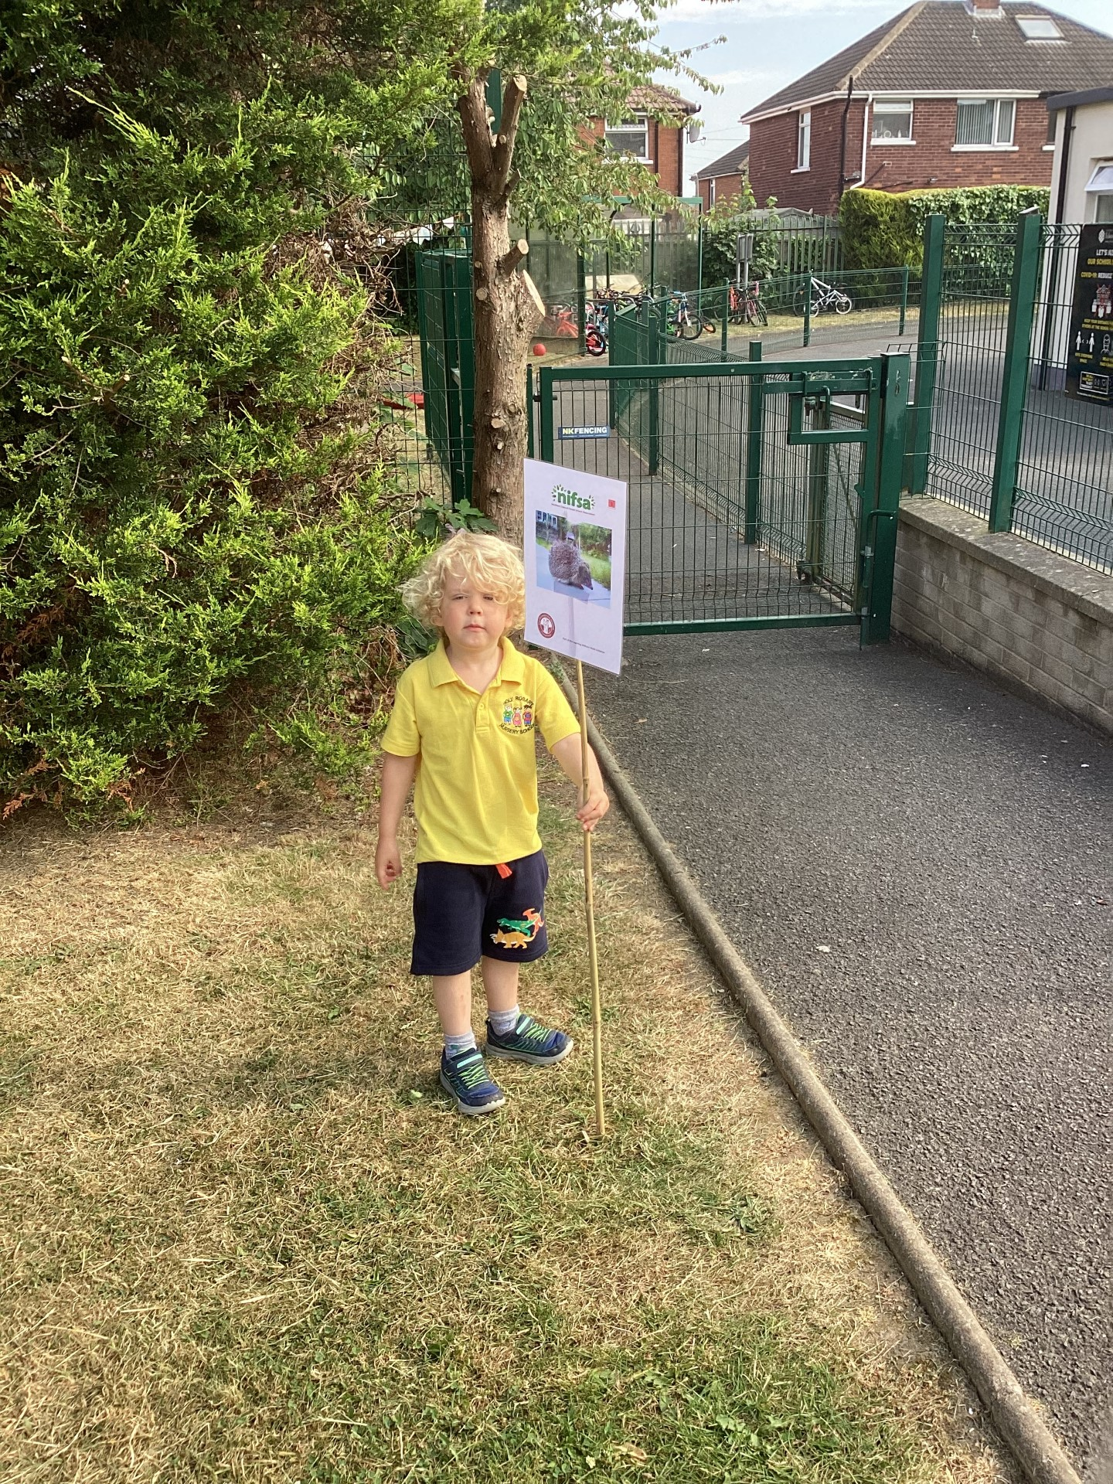
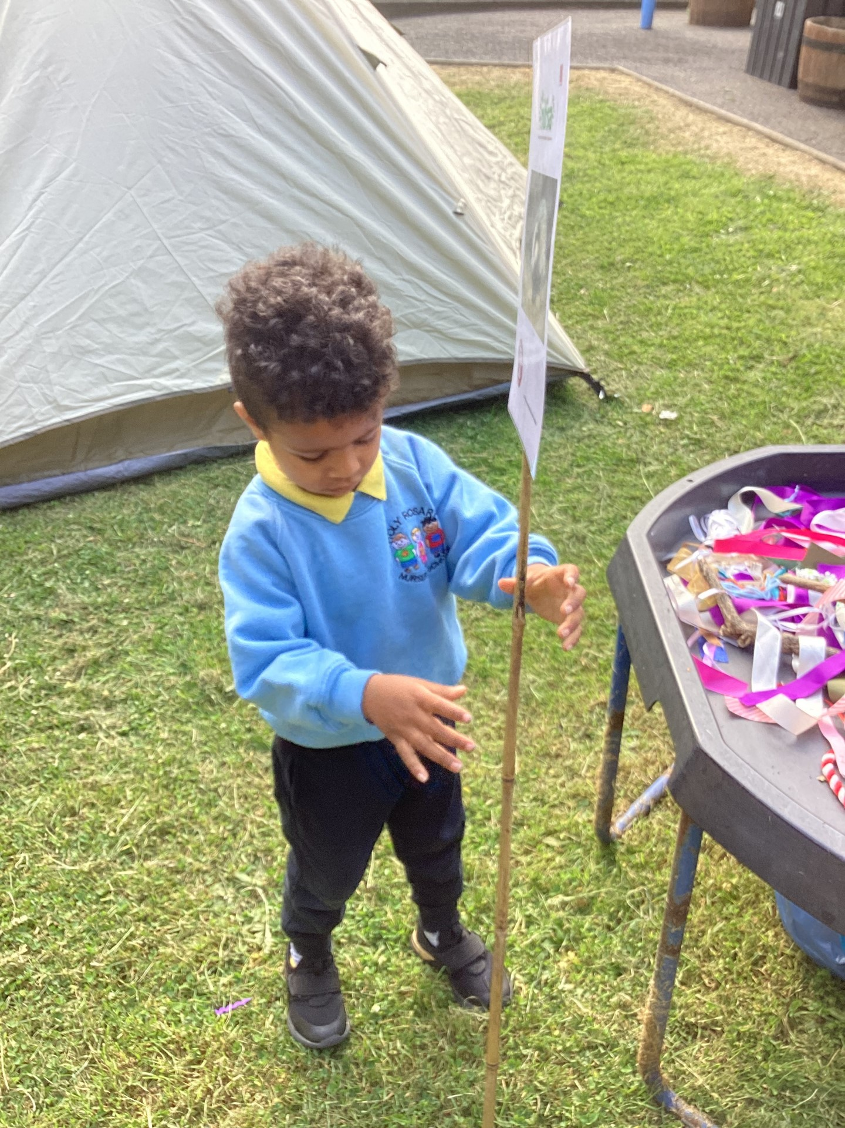
Boundary flags
Forest School Awards - The outreach
programme for Learning Without Walls
We put out the boundary flags so we know the area we have to stay inside

Slide 4
Rules
We go through the rules – 1 whistle means stop, 2 whistles mean come back to base and the 3rd rule is to have fun & learn!
Forest School Awards - The outreach
programme for Learning Without Walls

Slide 5
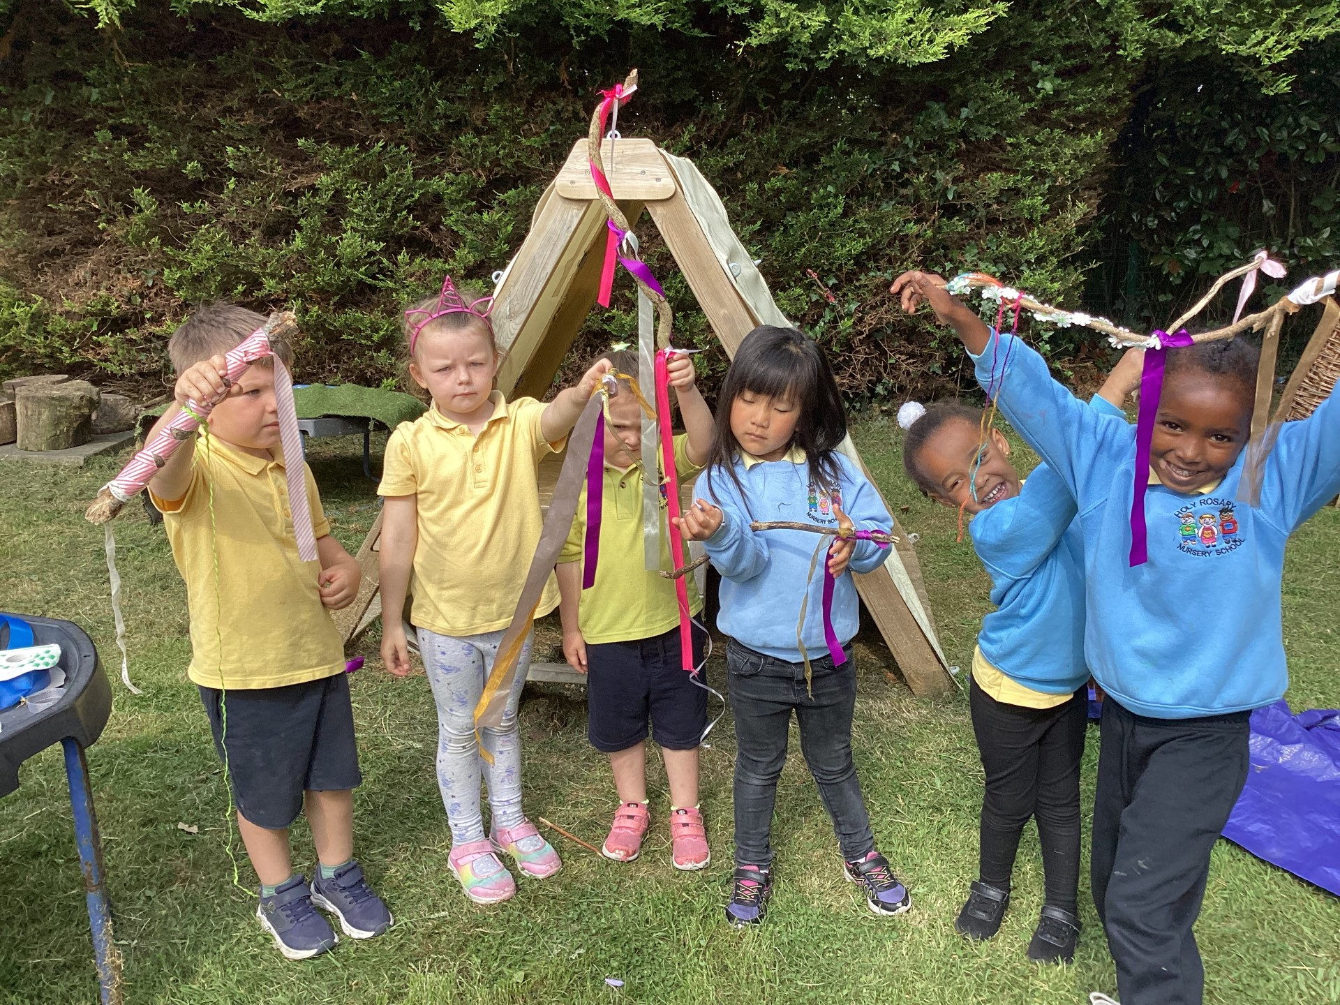
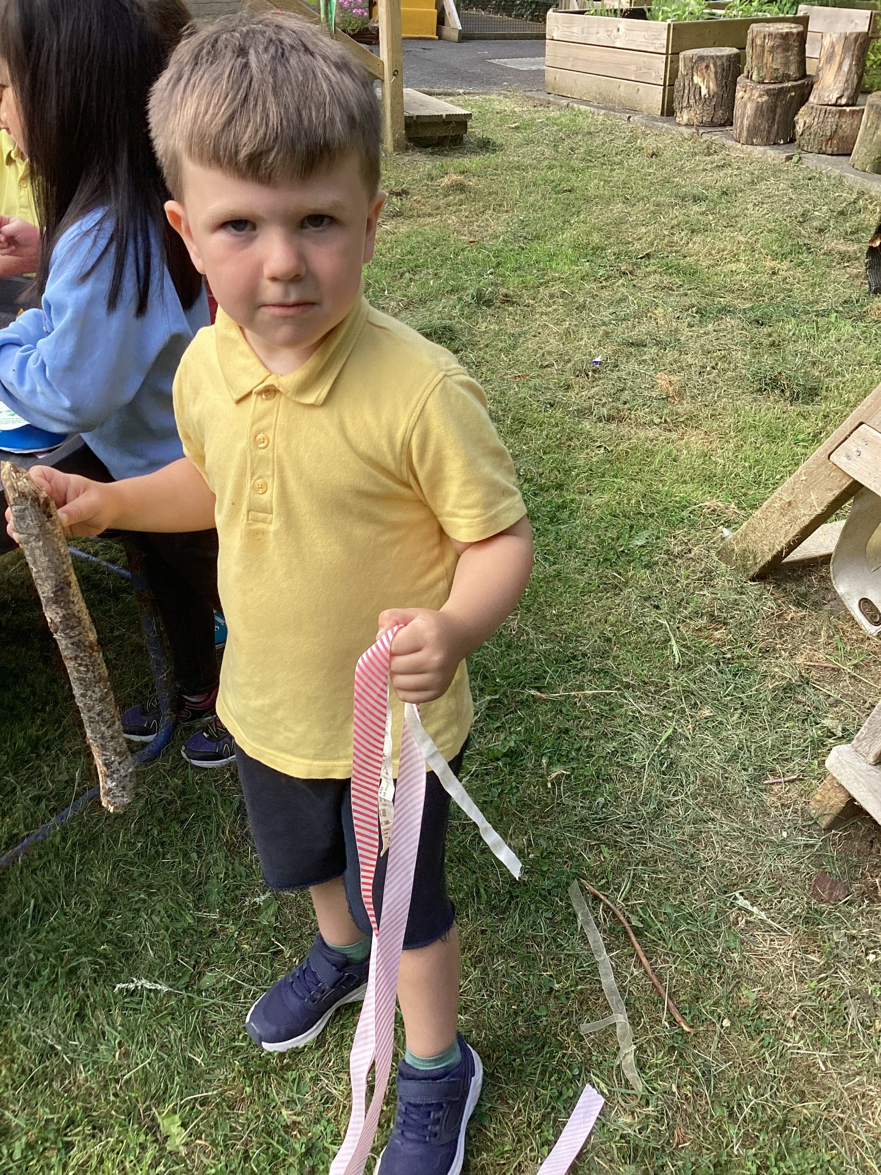
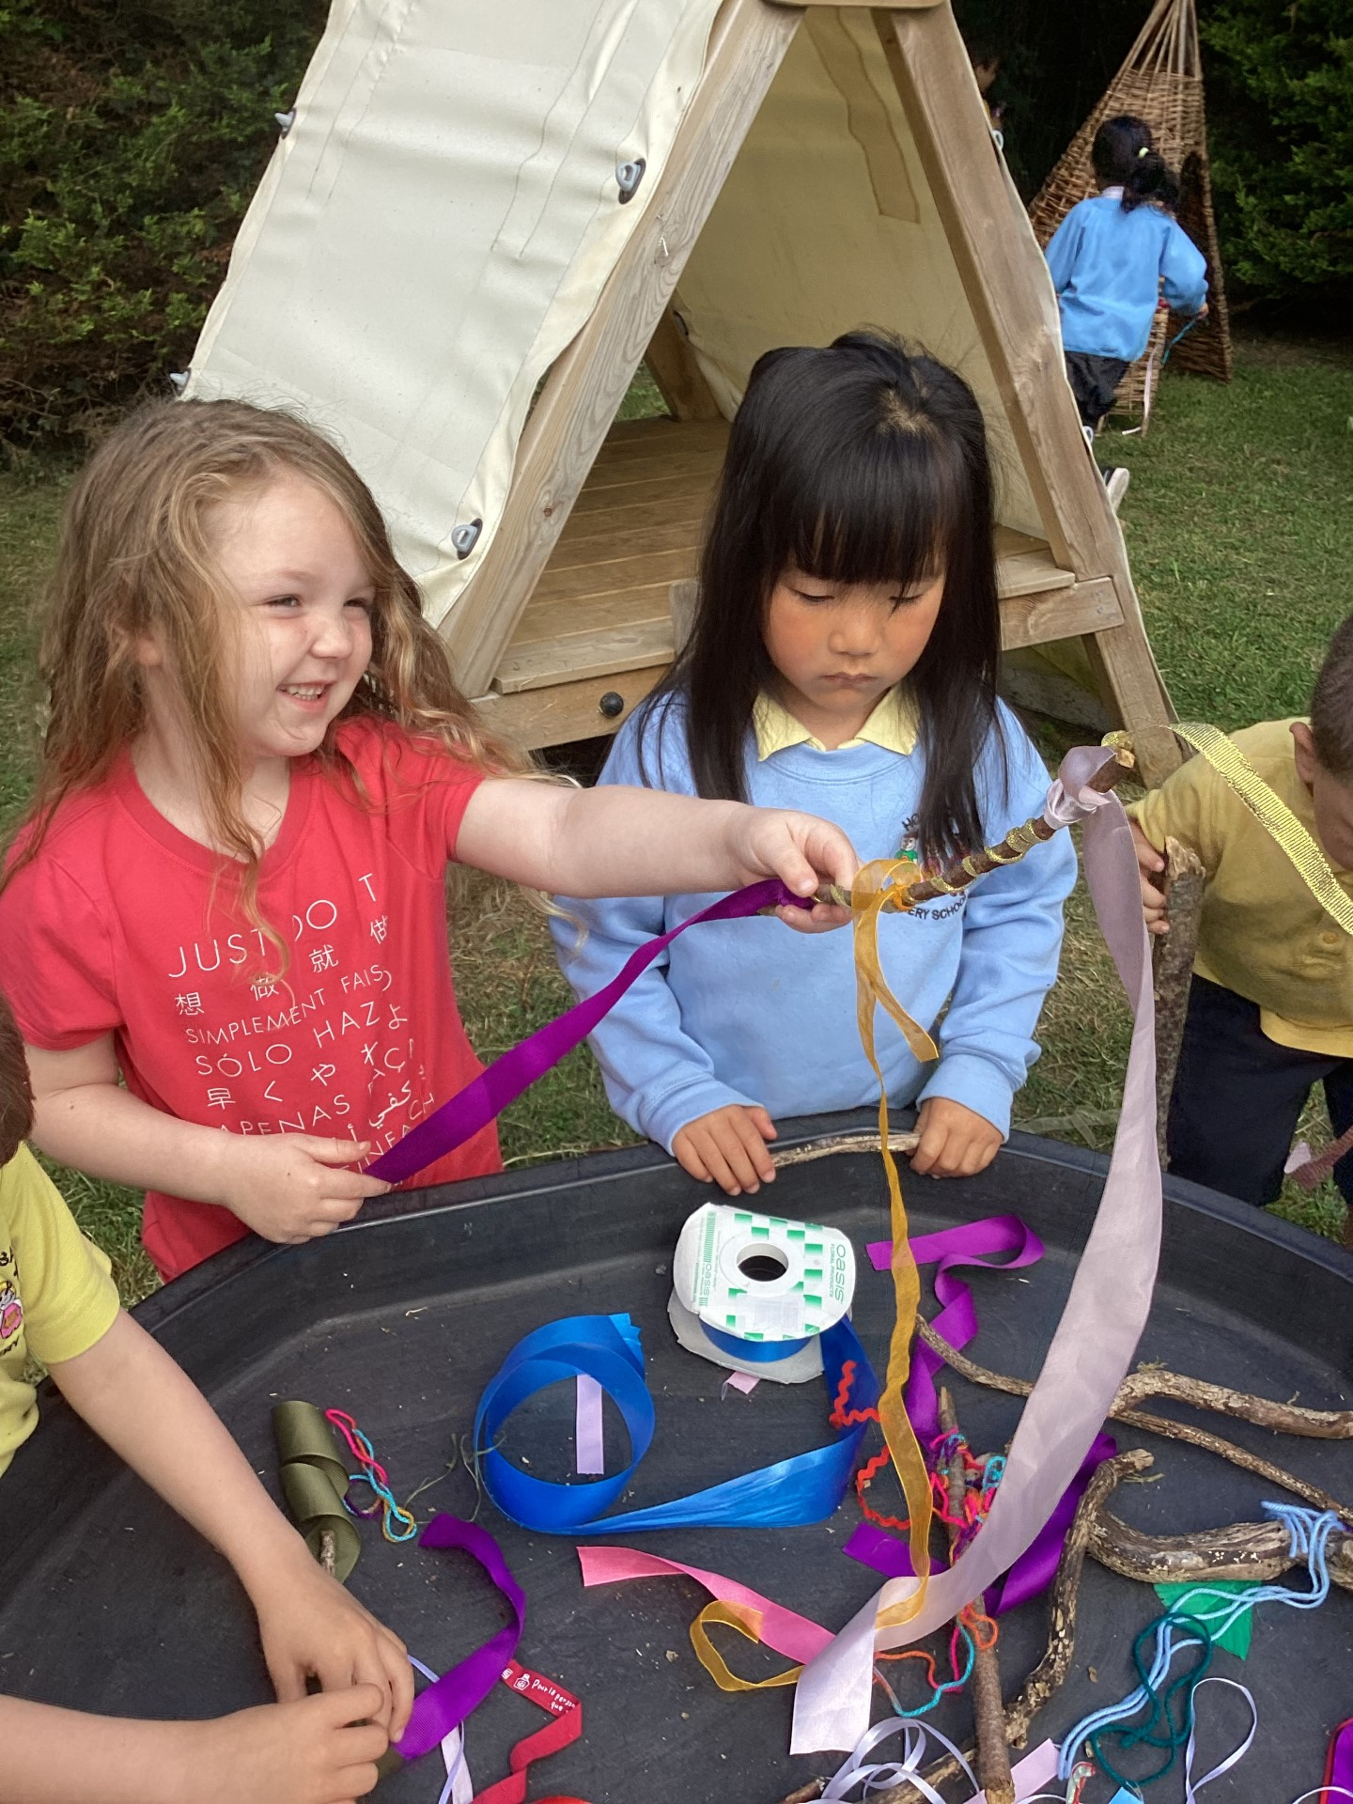
Nature streamers
We searched for sticks in our forest area, then wound ribbons around them to make nature streamers.
Forest School Awards - The outreach
programme for Learning Without Walls

Slide 6
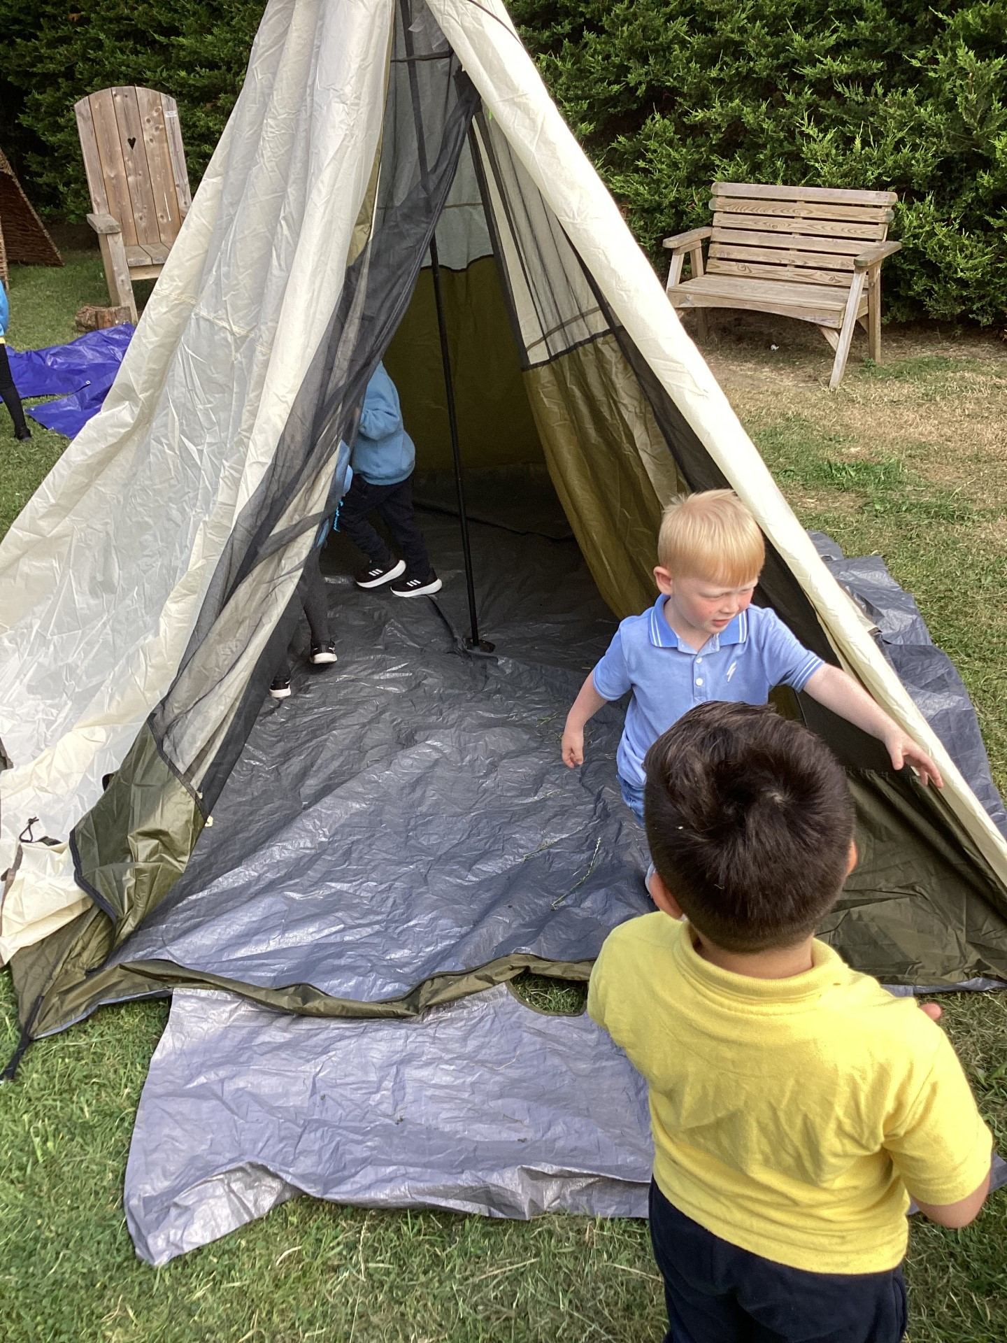
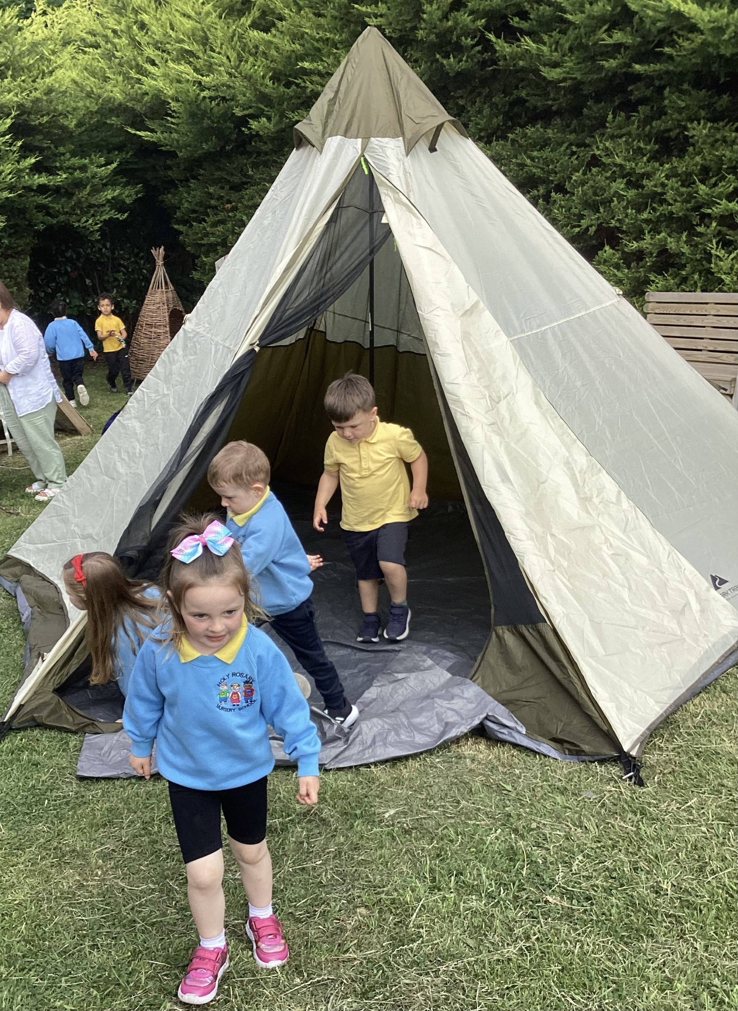
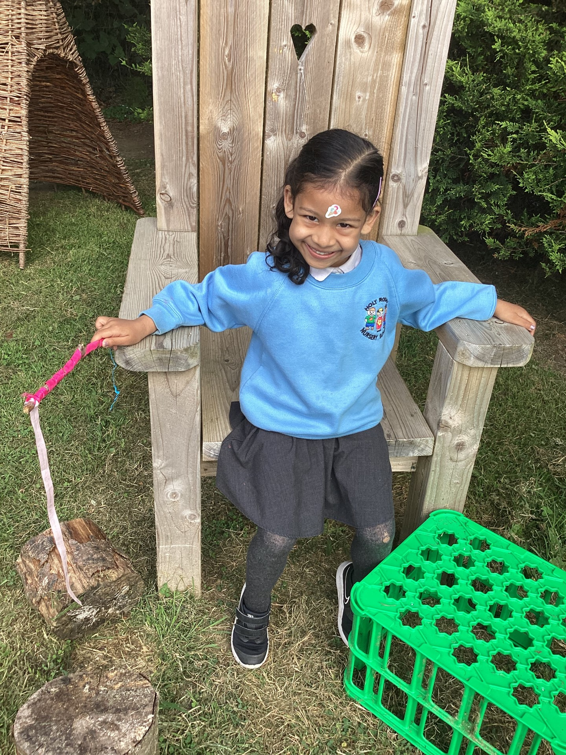
Play time!
We finished our session with some play time!
Forest School Awards - The outreach
programme for Learning Without Walls

Slide 7
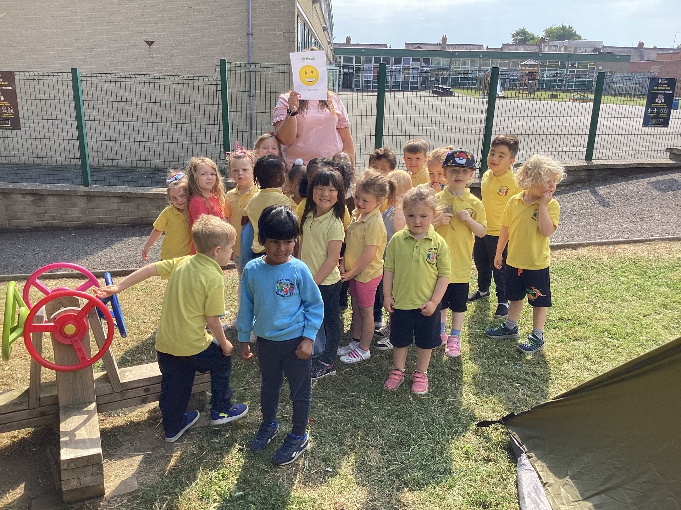
Evaluation
Everybody loved today’s session. No sad faces!
Forest School Awards - The outreach
programme for Learning Without Walls
or
???

Slide 8
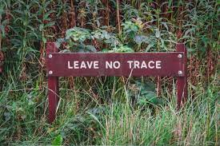
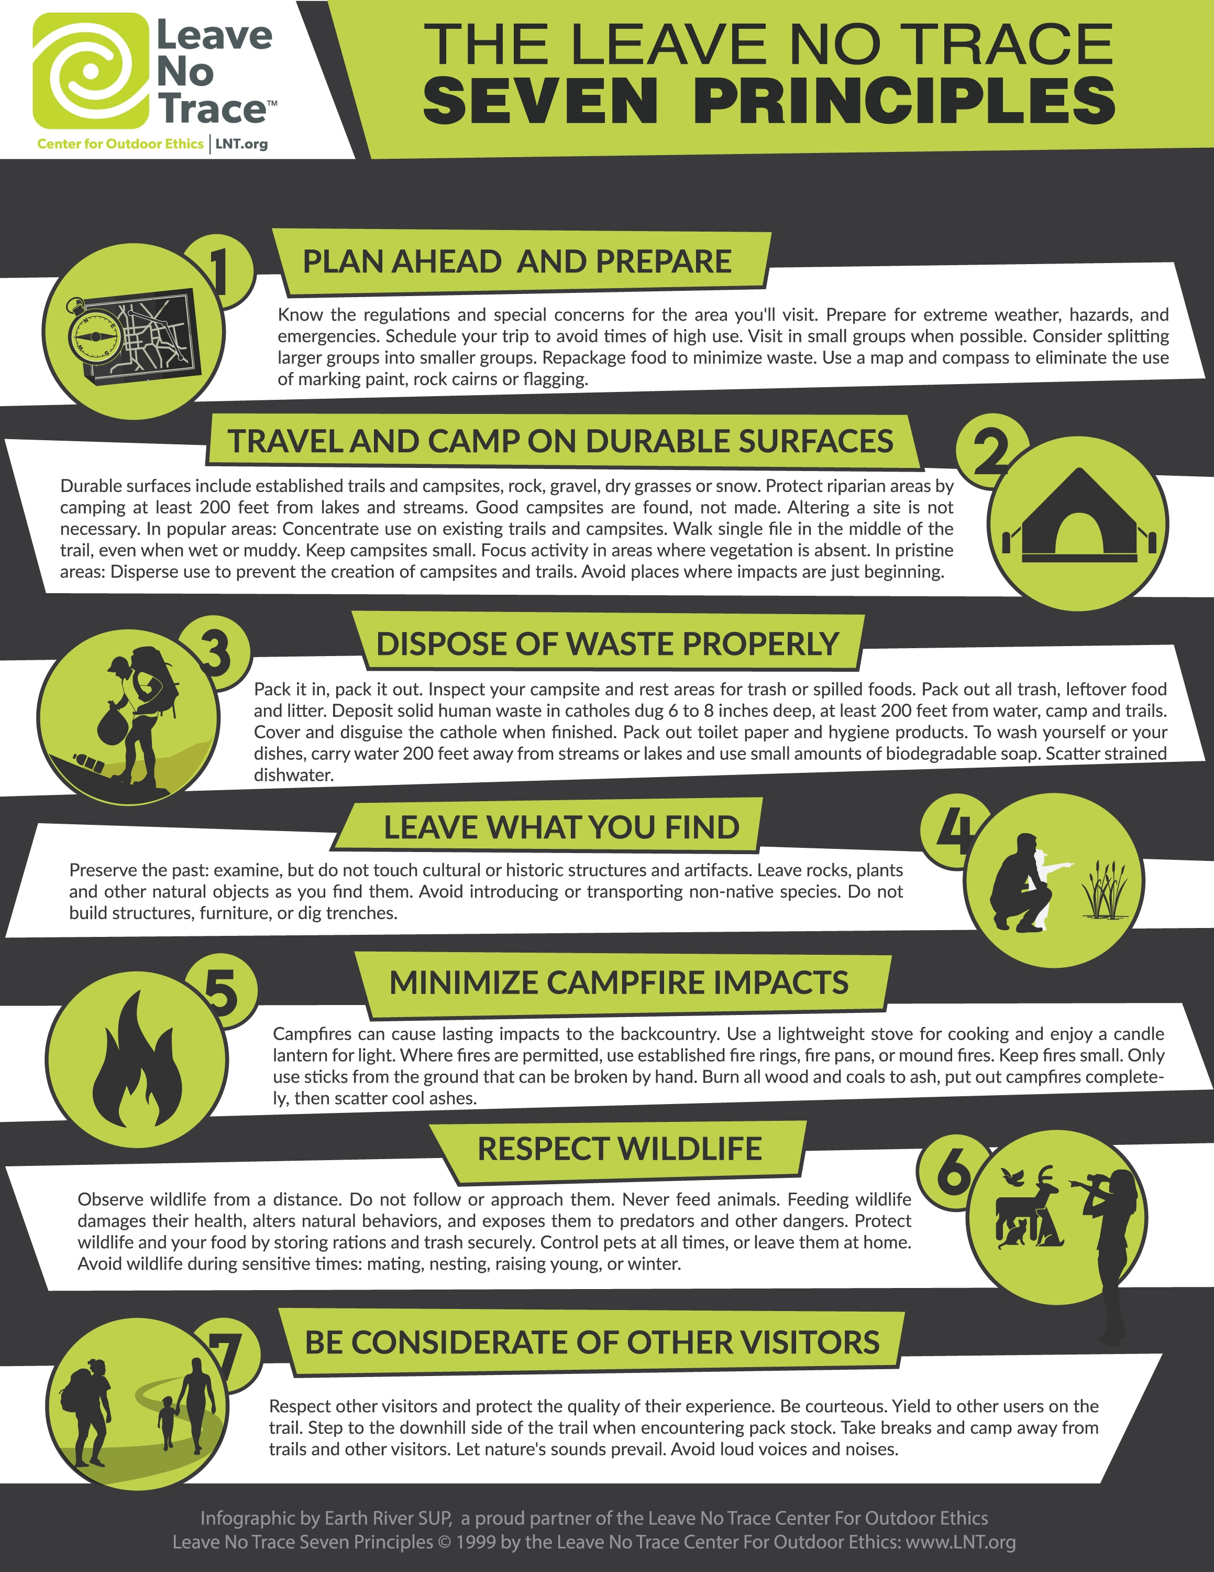
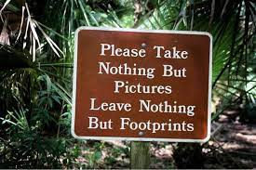
Leave no trace
Everyone helped to tidy up our site and leave no trace, in keeping with Forest School philosophy.
Forest School Awards - The outreach
programme for Learning Without Walls

