Slide 1
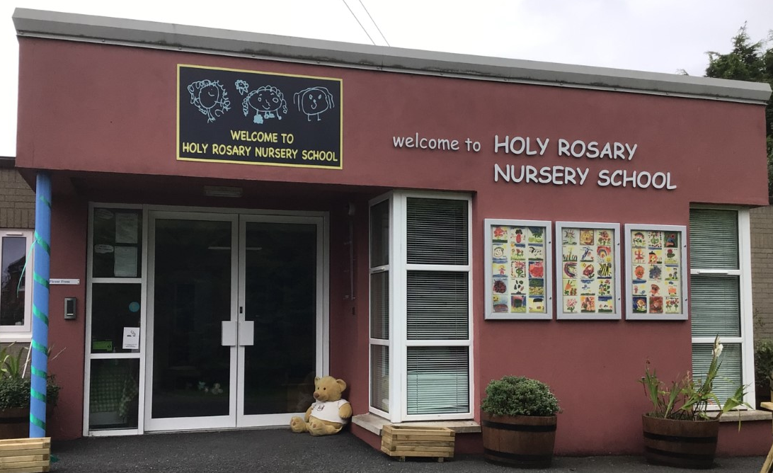
Holy Rosary Nursery School Our forest school diary 30th January 2024
Forest School Awards - The outreach
programme for Learning Without Walls

Slide 2
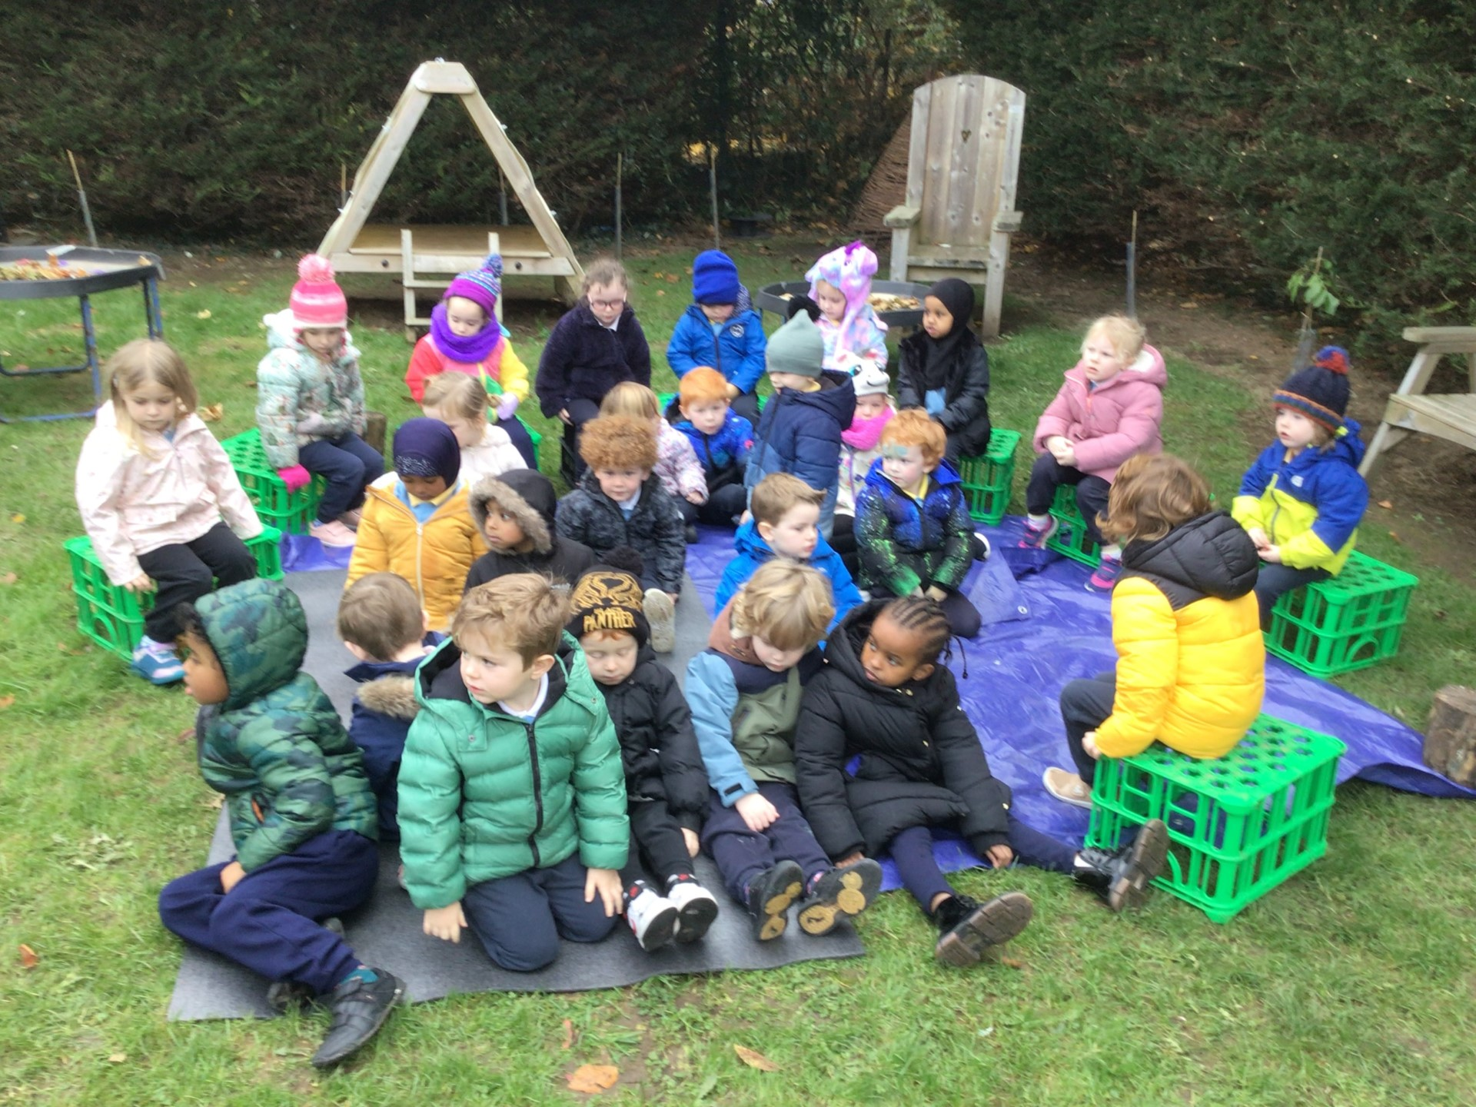
Safety first!
Forest School Awards - The outreach
programme for Learning Without Walls
We made sure the site was safe and listened carefully to what we had to do!

Slide 3
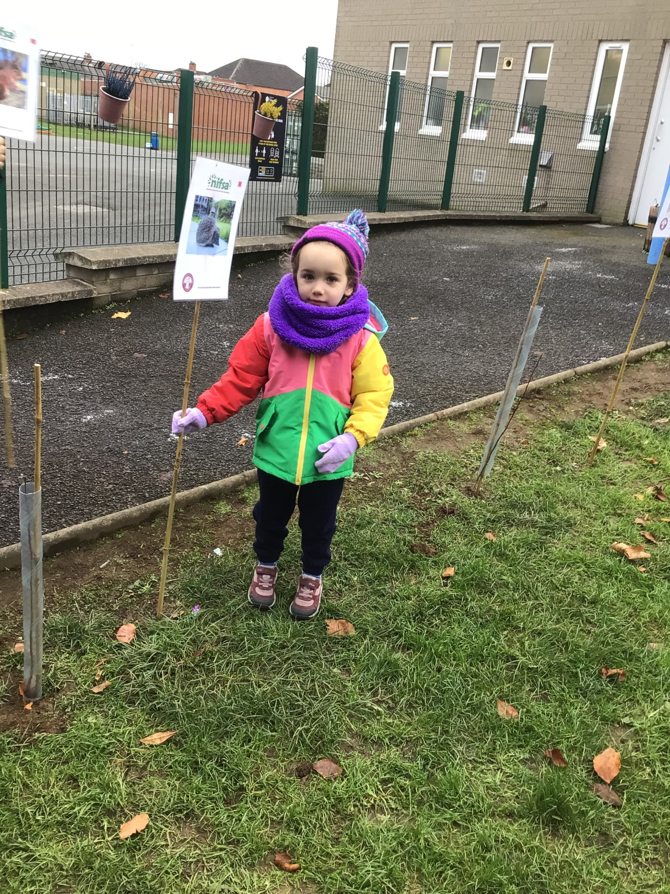
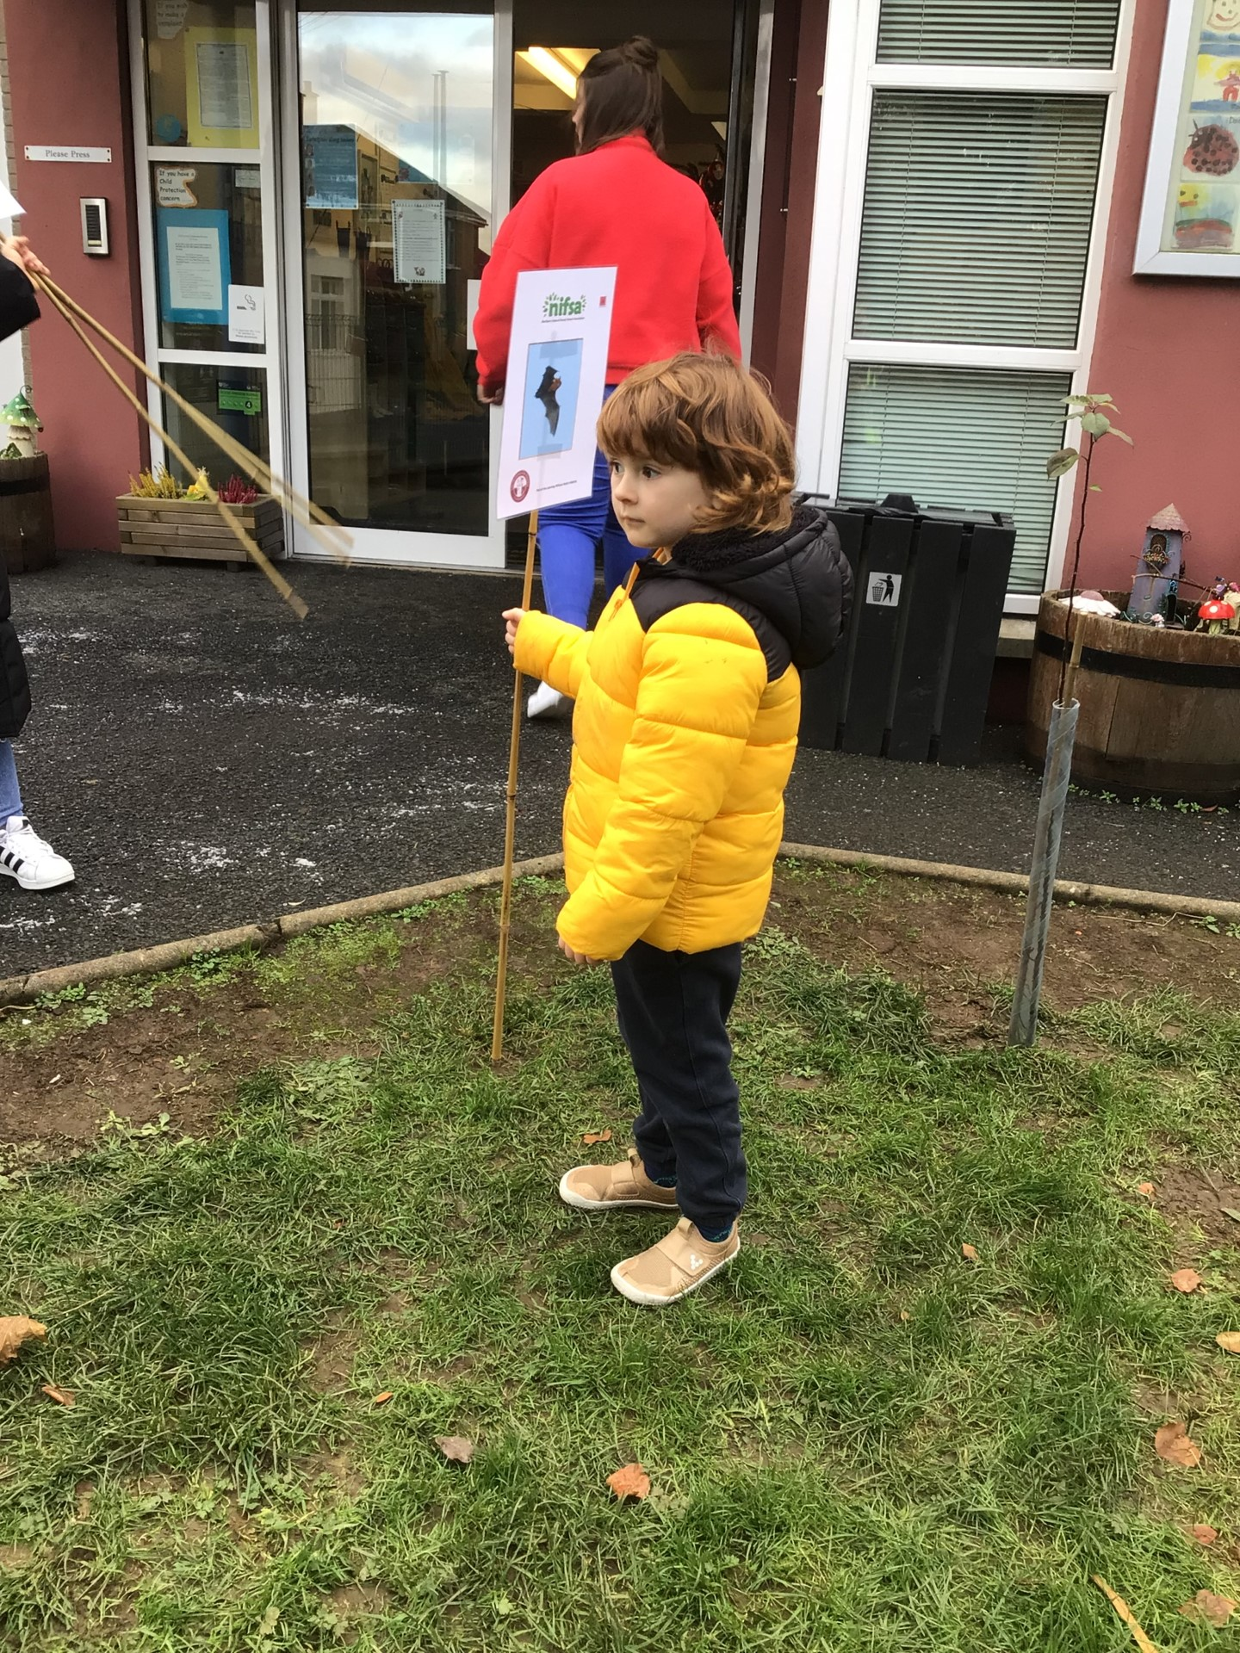
Boundary flags
Forest School Awards - The outreach
programme for Learning Without Walls
We put out the boundary flags so we know the area we have to stay inside

Slide 4
Rules
We go through the rules – 1 whistle means stop, 2 whistles mean come back to base and the 3rd rule is to have fun & learn!
Forest School Awards - The outreach
programme for Learning Without Walls

Slide 5
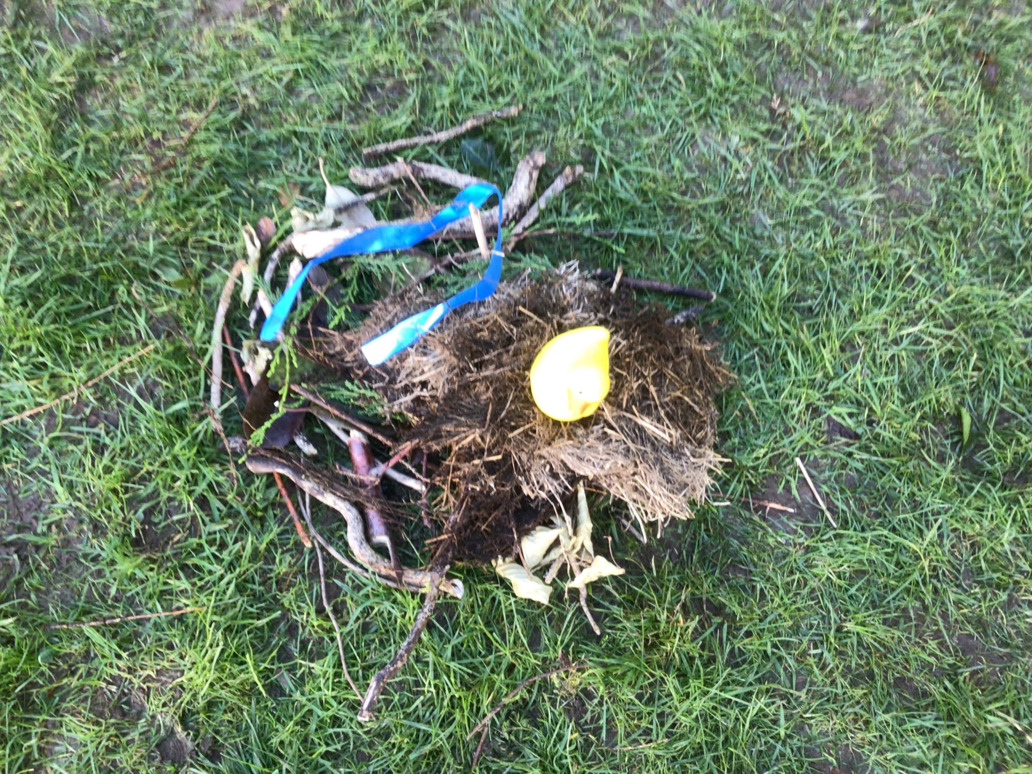
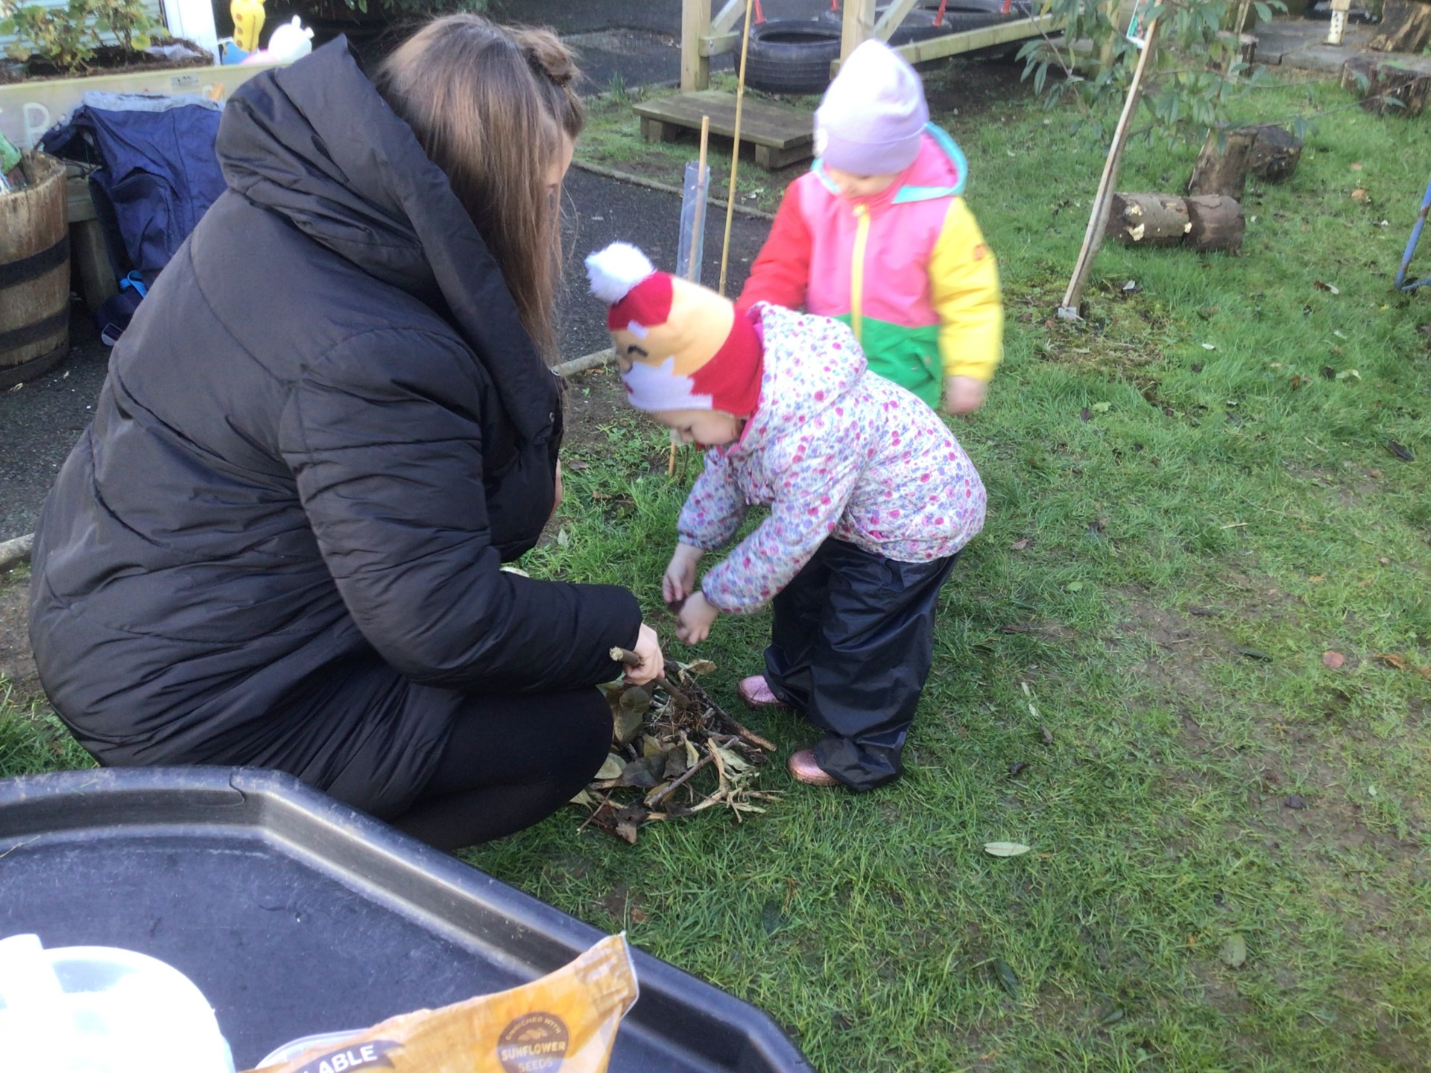
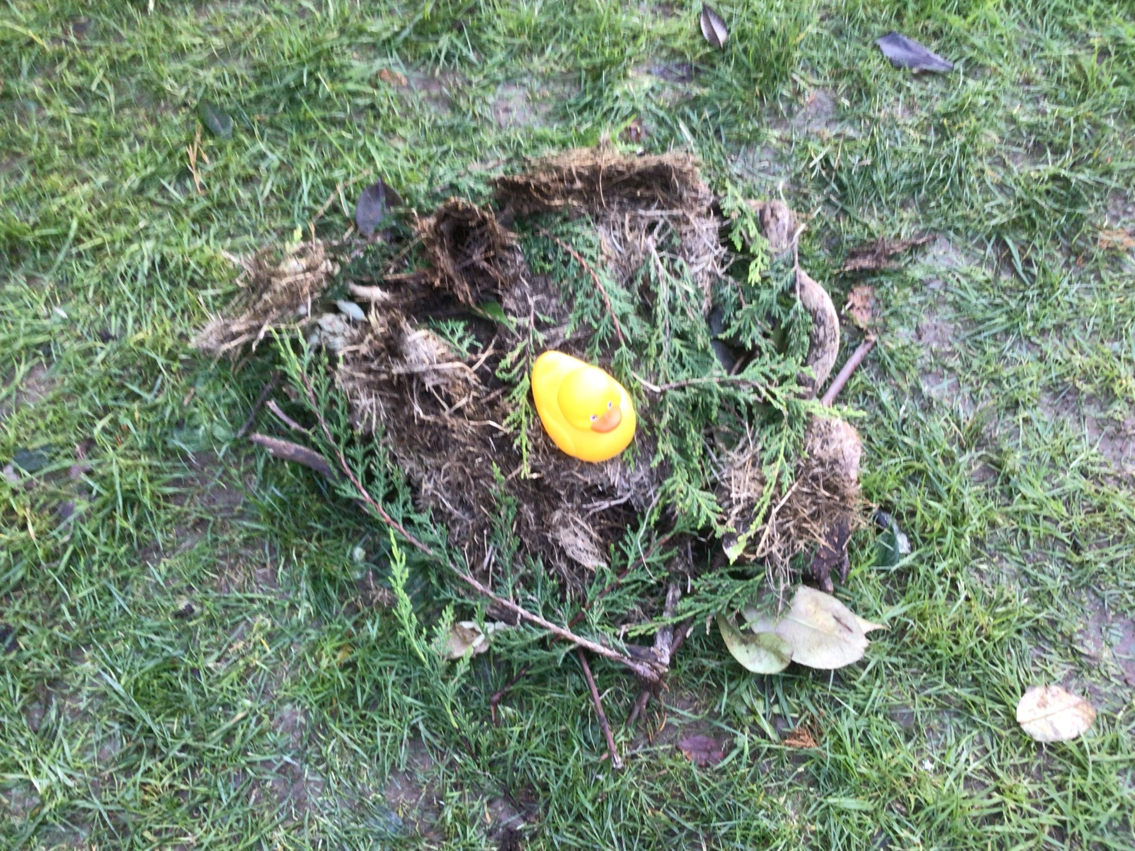
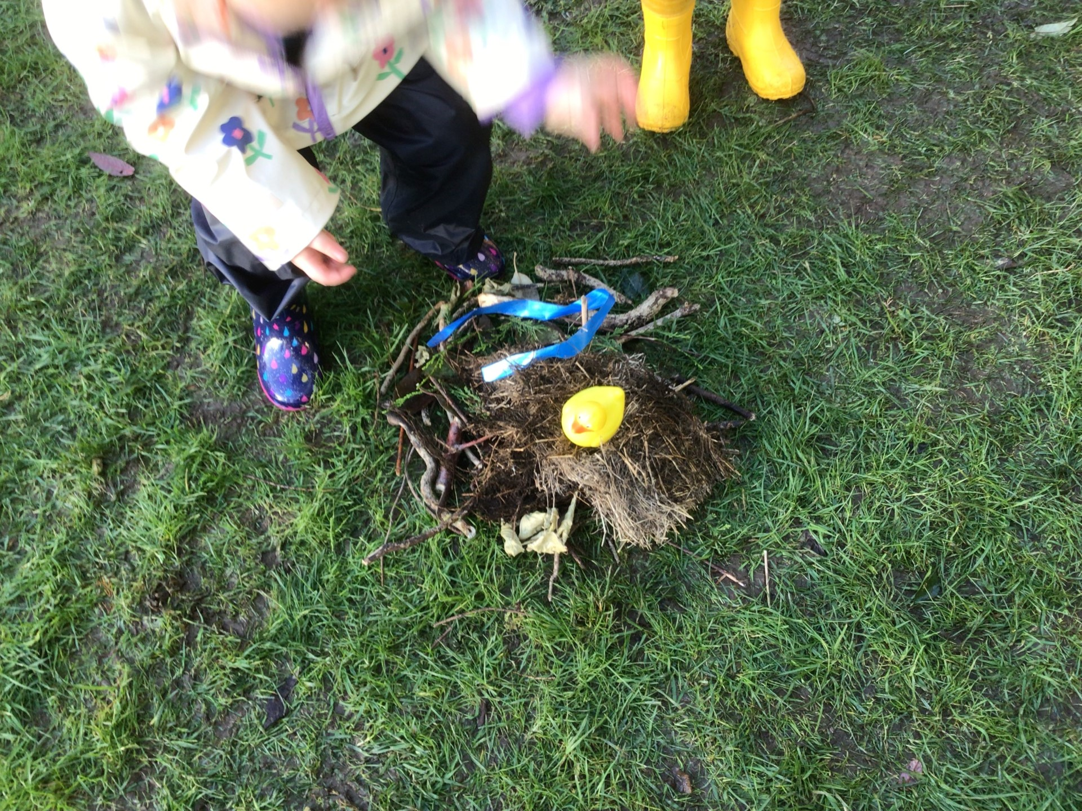
Birds’ nests
We looked at pictures of birds’ nests and identified the common features of these. We gathered materials from the forest floor to make our own nests.
Forest School Awards - The outreach
programme for Learning Without Walls

Slide 6
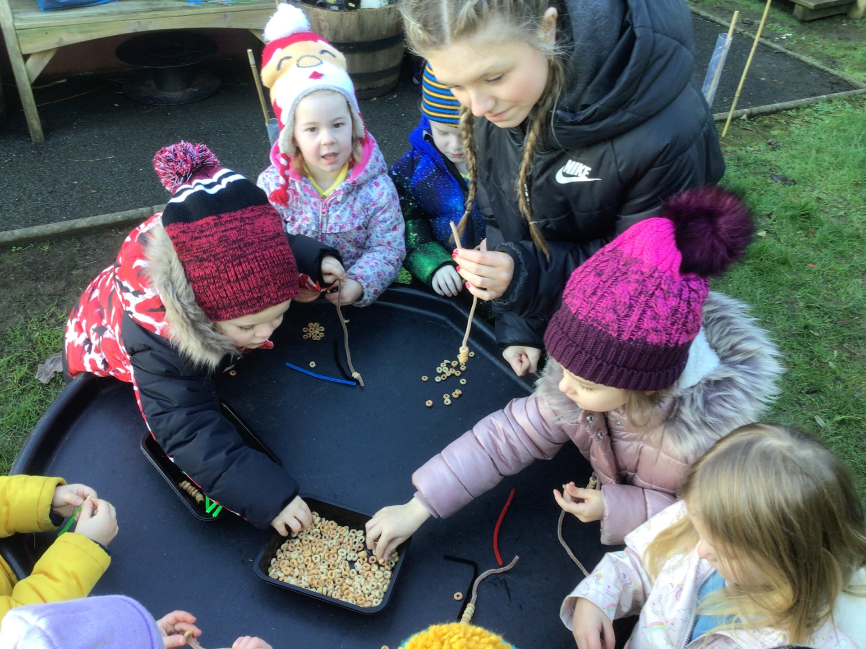
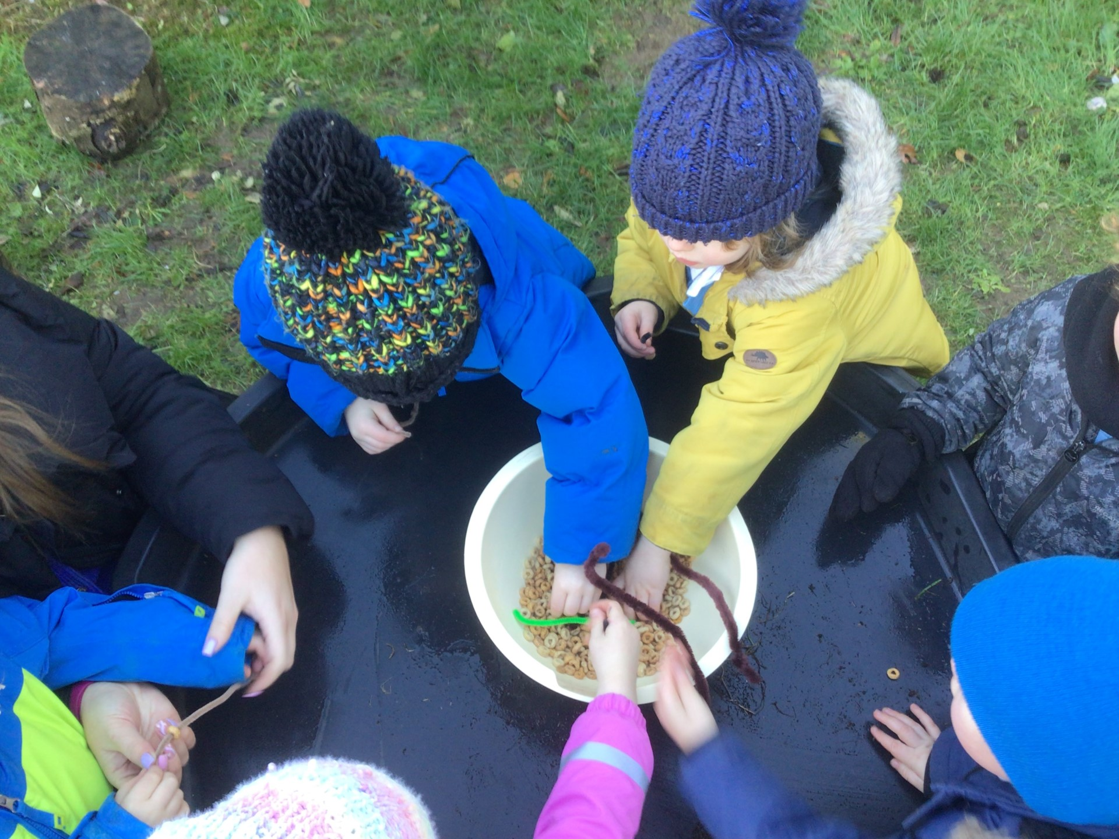
Bird feeders
Next we threaded cheerios onto pipecleaners to make bird feeders and hung them on the trees
Forest School Awards - The outreach
programme for Learning Without Walls

Slide 7
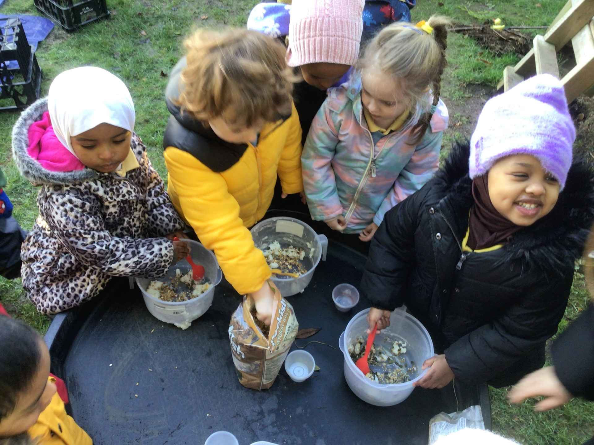
Fat balls
We mixed lard and bird seed together and made fat balls for the birds too!
Forest School Awards - The outreach
programme for Learning Without Walls

Slide 8
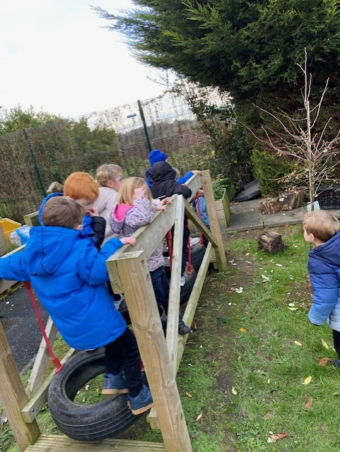
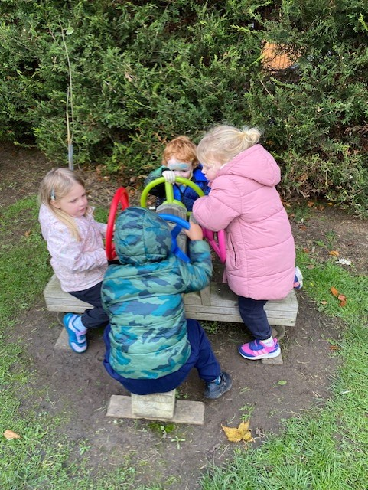
Play time!
We finished our session with some play time!
Forest School Awards - The outreach
programme for Learning Without Walls

Slide 9
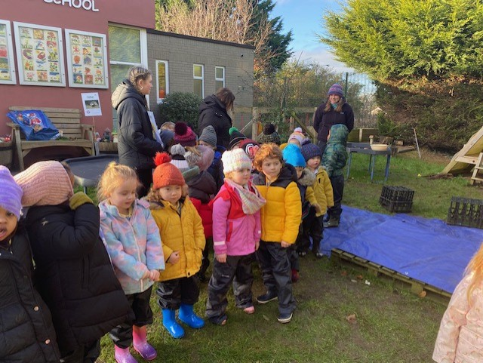
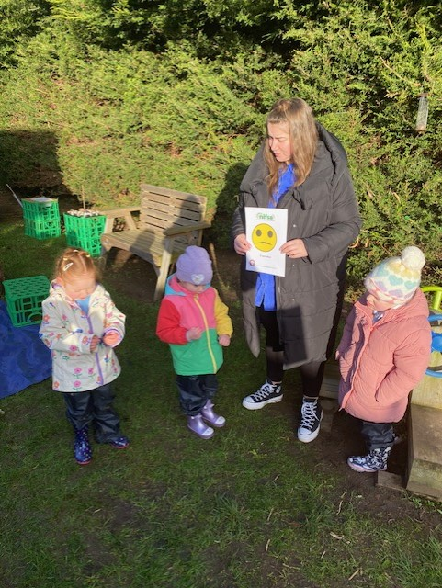
Evaluation
Mostly happy faces today!
Forest School Awards - The outreach
programme for Learning Without Walls
or
???

Slide 10
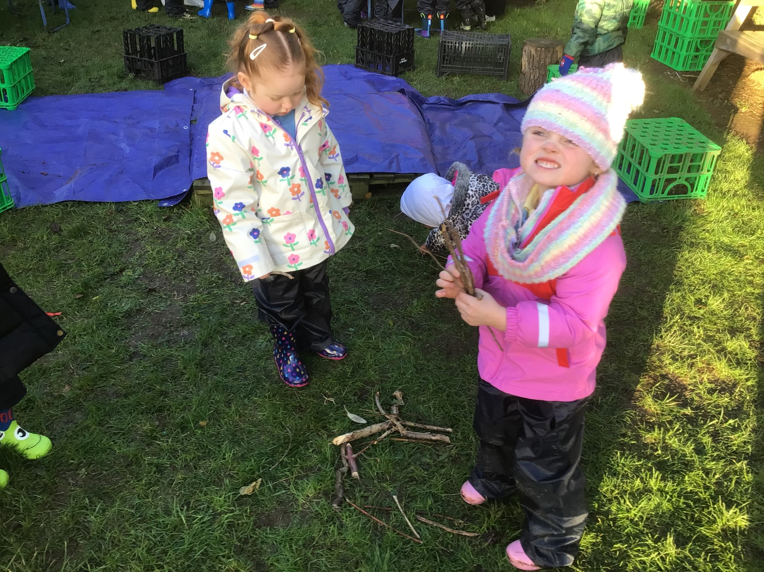
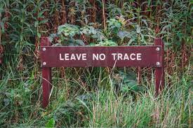
Leave no trace
Everyone helped to tidy up our site and leave no trace, in keeping with Forest School philosophy.
Forest School Awards - The outreach
programme for Learning Without Walls

